Slide 1
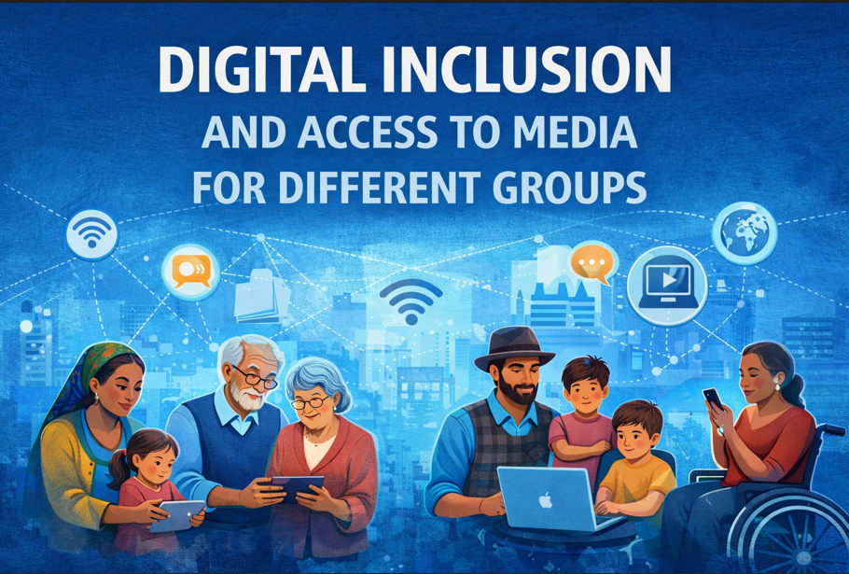

Slide 2

Introduction
Digital inclusion - essential for equitable participation in contemporary society
Different Social Groups:
  Alder Adults/Seniors
  Low-Income Household
  Rural Communities
  Migrants and Linguistic Minorities
  Persons with Disabilities

Slide 3
What Is Digital Inclusion?
Physical access (devices, broadband)
Digital skills and literacy
Accessible content
Affordable services
Meaningful participation

Slide 4

Why Digital Inclusion Matters in the EU?
90%+ EU households have internet
access
Access ≠ inclusion
Digital exclusion reinforces:
  Economic inequality
  Social isolation
  Democratic vulnerability
  Media marginalization
Eurostat, European Commission

Slide 5
The EU Digital Inequality System
Digital inequality
Income
Age
Migration status
Education &
Skills
Disability
Rural location

Slide 6
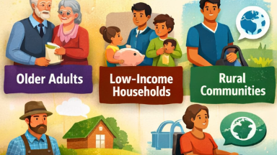
Digital Inclusion Across Different Social Groups

Slide 7

Older adults (65+)
Seniors often face barriers to digital participation: access, skills, and motivation
Media education - a bridge to foster digital literacy, empowerment, and social connection

Slide 8
Why media literacy for older adults matters?
Digital media shapes
civic participation health decisions social connections
Seniors are frequently targeted by misinformation
risk group of exclusion

Slide 9
The Role of Media Education
Helps seniors critically understand and engage with digital content
Promotes active participation rather than passive consumption
Enhances self-efficacy and trust in technology

Slide 10

Strategies for Engaging Seniors
Use participatory, hands-on learning methods +
interactive intervention
Focus on relevance — connect digital tools to personal interests and daily needs
Encourage peer and intergenerational learning
Foster safe and supportive learning environments

Slide 11
Key principles for effective media education with seniors
Learner-centred design: build from learners’ goals and contexts (health, family contact, civic info)
1
Trusted, supportive learning environments:
‘warm experts’ (family/friends)
2
Hands-on, scaffolded practice: small steps, real tasks (e.g., verifying a news post)
3
Sustained support & local partnerships: single workshops, follow-up support
4

Slide 12
Low income household
less access to digital devices
lower levels of digital literacy
lack of benefit from the informational, promotional, or educational functions of the media
negative related to education and personal development
exclusion from public and social life
Inclusive pricing & multi-channel strategies

Slide 13

Rular vs Urban Divide
Slower broadband in remote regions
Lower digital infrastructure investment
Streaming-heavy campaigns may not reach rural audiences effectively

Slide 14

Persons with Disabilities
87 million people in EU live with disabilities
Accessibility barriers in media & websites

Slide 15

Migrants and Linguistic Minorities
Language barriers
Cultural representation gaps
Digital exclusion risk
Localization strategies
Inclusive narratives build brand trust

Slide 16

The Hidden Market Loss
If brands ignore digitally excluded groups:
Reduced total addressable market
Reputational risk
Regulatory penalties
Weak CSR credibility
Inclusive design = market expansion

Slide 17

Strategic Recommendations
Adopt inclusive design
Combine digital + offline communication
Invest in media literacy initiatives
Use data ethically
Audit digital bias in campaigns
Small design changes → large systemic impact

Slide 18
Thank You
Blandína Šramová
Tomas Bata University
Czechia

