Slide 1
Media Education and Increasing Digital Literacy. Creation of Educational Projects
Michał Szyszka, WSB University, PL

Slide 2

Lucas Zimmermann, Solitude palace

Slide 3
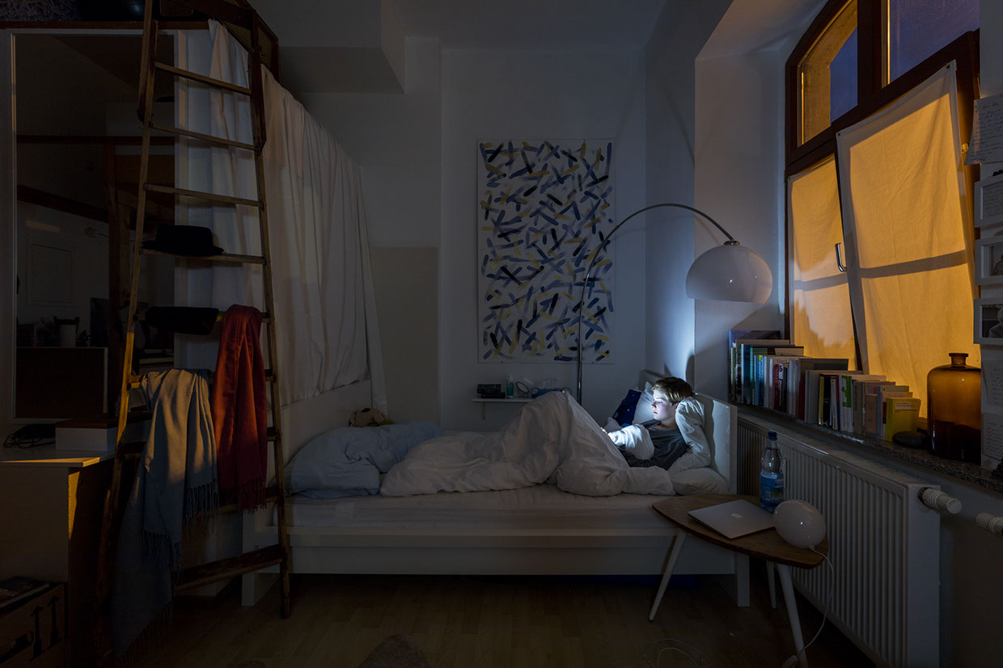

Slide 4
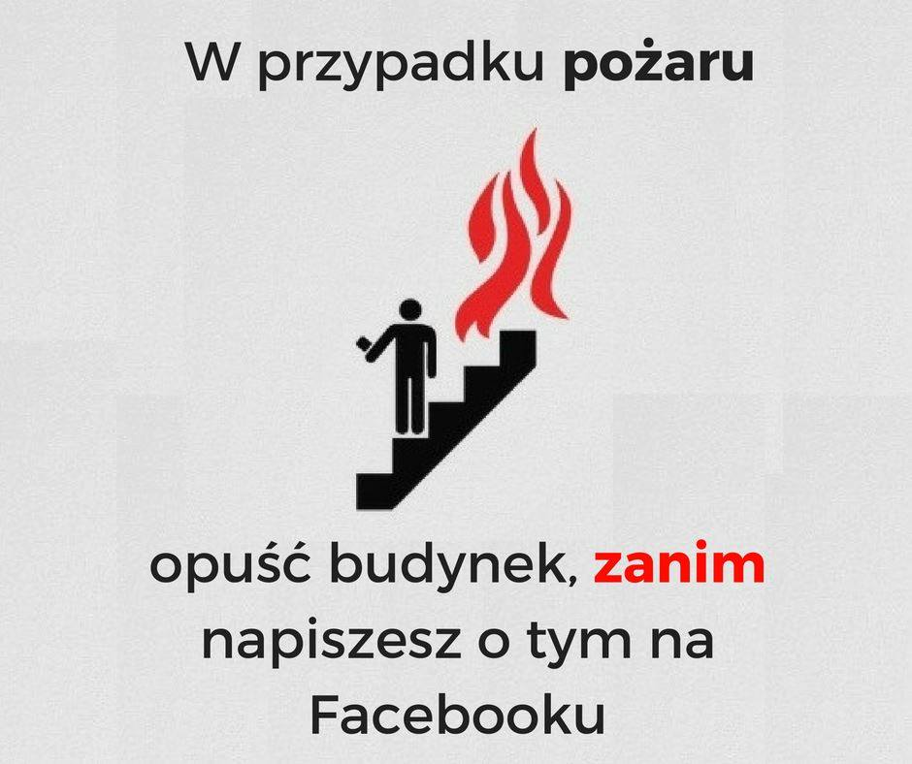

Slide 5
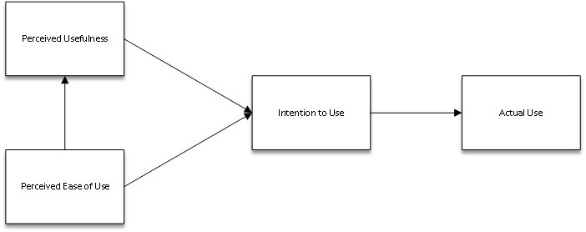

Slide 6
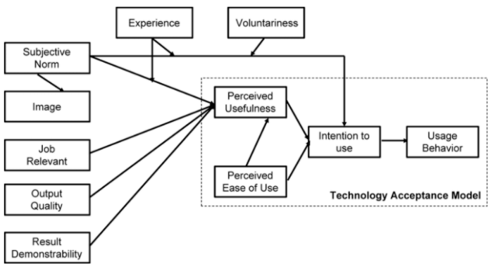

Slide 7
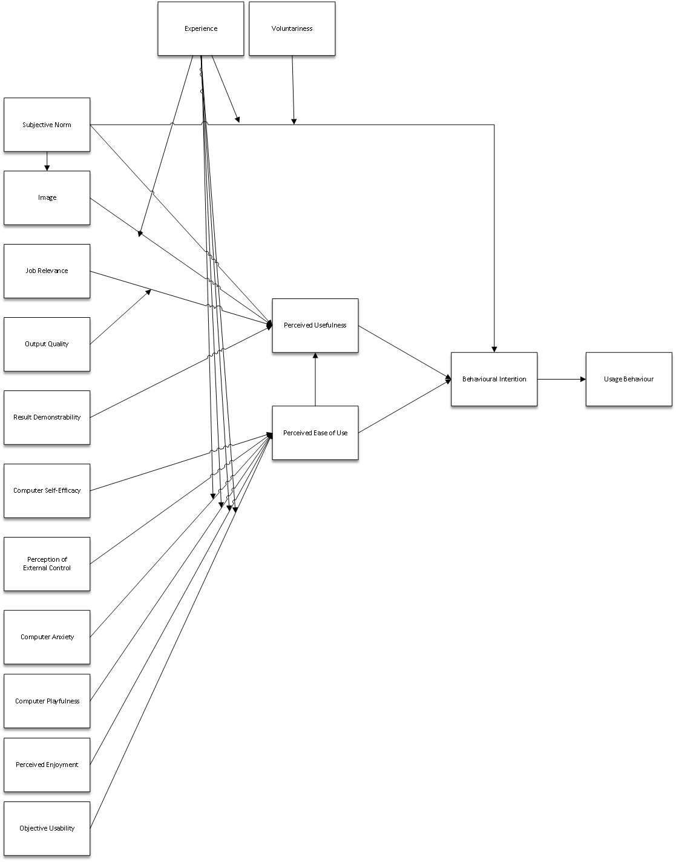
https://www.youtube.com/watch?v=brdzjdRnU-A

Slide 8
Title: School Digitization in the Perspective of Teachers' Opinions and Experiences
Research Issues:
Frequency of ICT Use in Education
Attitudes toward New Media
Support from Management Staff
Research Problems
Q1: Which digital teaching aids are used most frequently?
Q2: To what extent does the use of digital teaching aids correlate with sociodemographic variables?
Q3: What is the level of correlation between the use of digital teaching aids?
Q4: To what extent is support from school management staff associated with the increased use of digital teaching aids?
Q5: To what extent do regulations regarding smartphone use in schools correlate with the frequency of digital teaching aids?

Slide 9
Procedura badawcza
Diagnostic survey method, online survey technique.
Webankieta commercial platform.
In addition to the survey questionnaire, 20 questions grouped into two main research areas.
Organizational support: Department of Education, Marshal's Office of the Silesian Voivodeship.
First wave: January 4, 2020 - March 15, 2020; (N=258) generalization at a confidence level of α = 0.95, fraction size = 0.5, maximum error not exceeding 7%.
Second wave: 2023 N=423
Silesian Voivodeship: a region with specific characteristics and a complex structure.
Research team: Dr. Michał Szyszka, Dr. Łukasz Tomczyk, Dr. Aneta Kochanowicz

Slide 10
Frequency of Digital Teaching Resources Use and Sociodemographic Variables
Co-occurrence of Digital Teaching Resources Use
Frequency of Teachers' ICT Use in Education and Management Support
Regulations on Smartphone Use and Frequency of Digital Teaching Resources Use in Schools

Slide 11
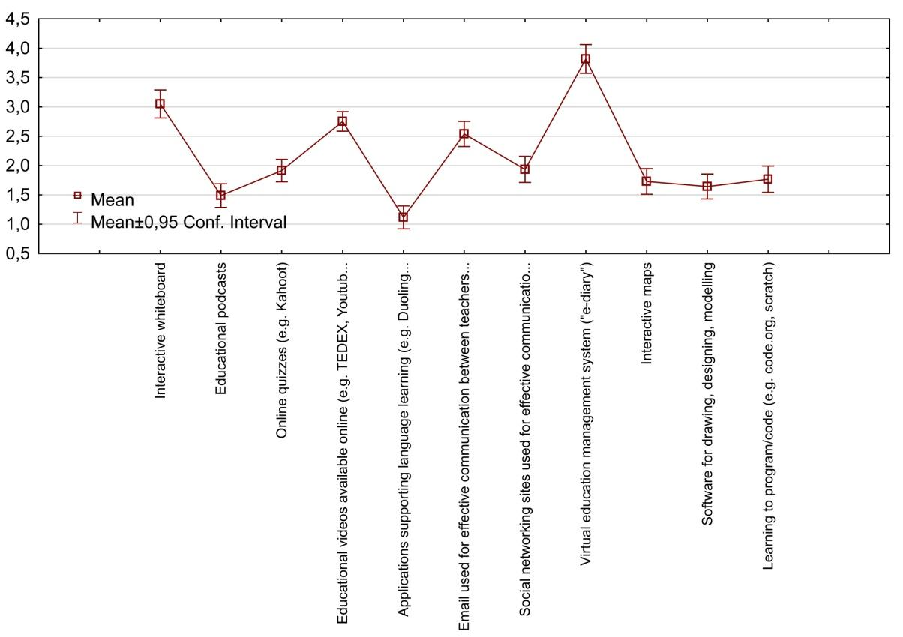
P1: Popularity of digital teaching aids among teachers
Q1: Which digital teaching aids are used most frequently?

Slide 12
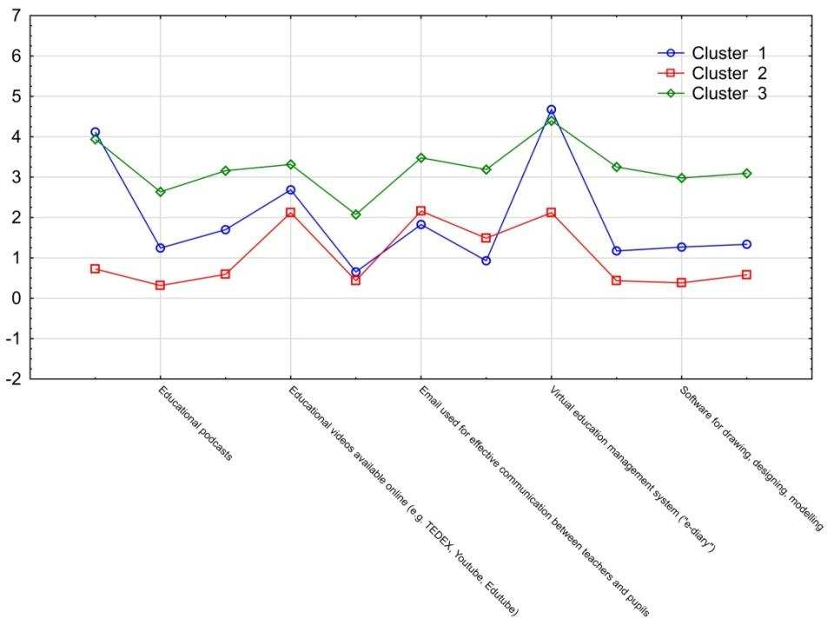
Tablica interaktywna
Podcasty edukacyjne
Quizzy online
Materiały video
Aplikacje do nauki j. obcych
Komunikacja elektroniczna
Sieci społecznościowe wyk. Do zadań edukacyjnych
Systemy zarządzania np. dziennik elektroniczny
Mapy interaktywne
Oprogramowanie do rysowania, projektowania, modelowania
Aplikacje/serwisy do nauko kodowania

Slide 13
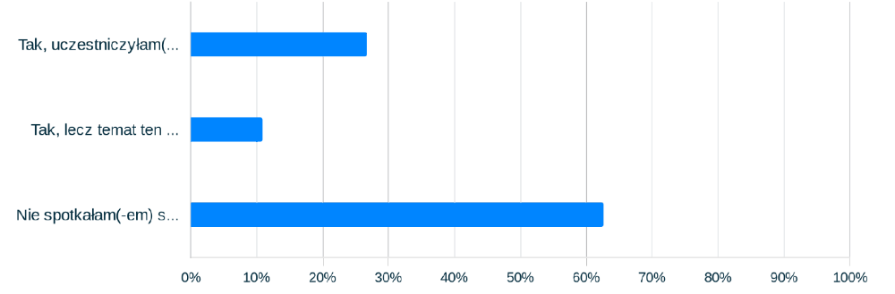
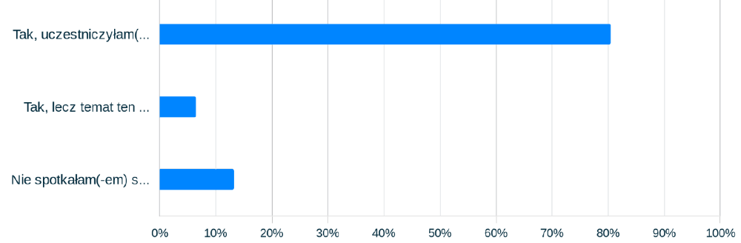
Participating in a course/training on the use of information and communication technologies in education

Slide 14
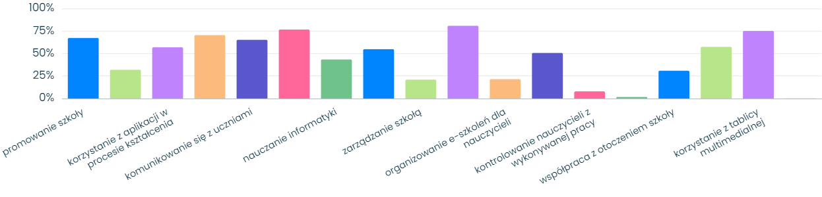
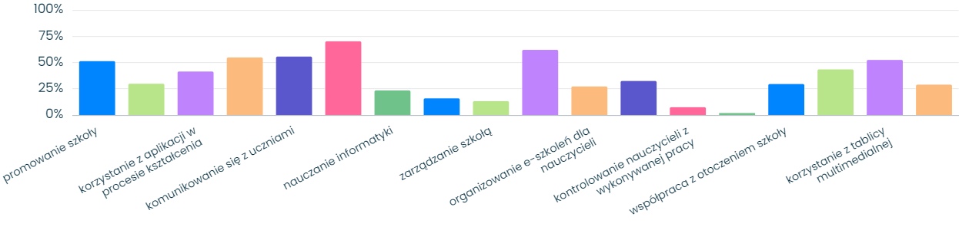
Using ICT at school - Typical activities
communicating
with school staff
providing students with
interesting materials
keeping an e-journal
teaching other subjects
sharing colleguages
educational materials
Using a multimedia
whiteboard
manipulating the recipient
recrutation
communicating with parents
Remote education during the COVID-19 pandemic

Slide 15
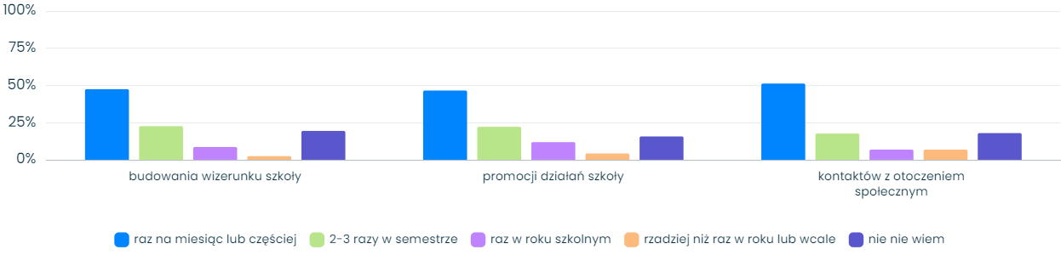
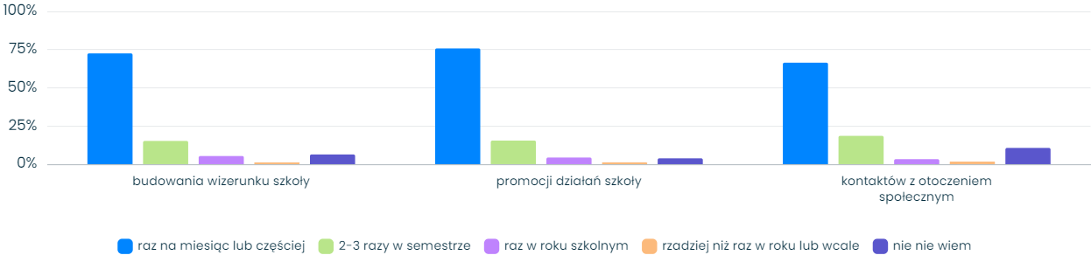
Using ICT in activities aimed at:
Once a month or more 2-3 times a semester Once a school year Less than once a year or not at all I don't know

Slide 16
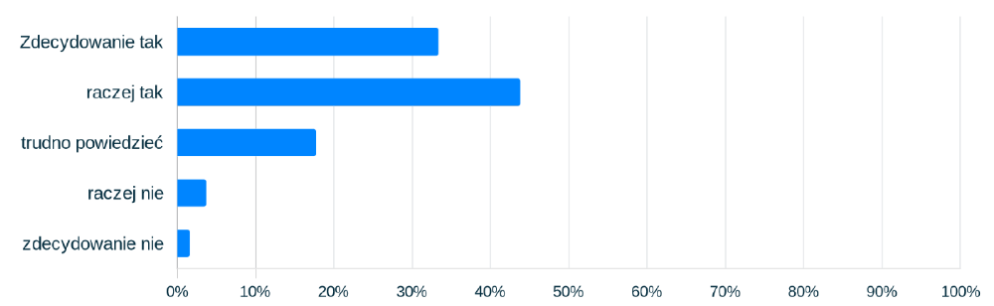
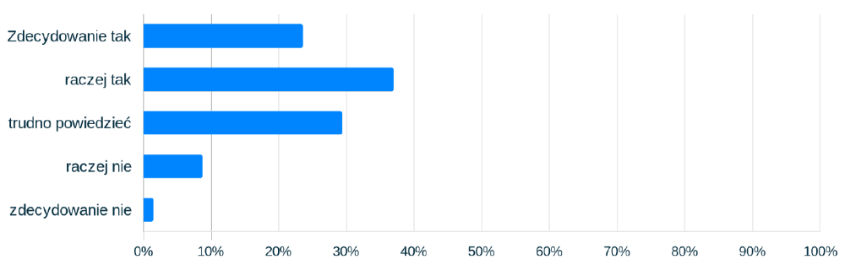
Is the use of information and communication technologies in your school an element of the communication strategy) (as a planned process of shaping relationships with the environment)
definitely yes
rather yes
hard to say
rather no
definitely no
definitely yes
rather yes
hard to say
rather no
definitely no

Slide 17
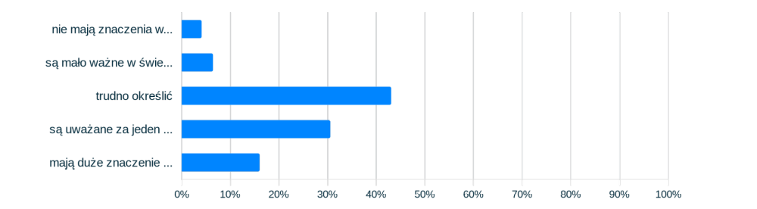
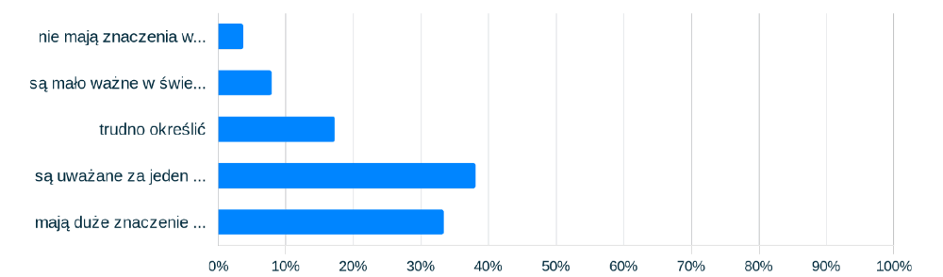
An attempt to assess the importance of media activities in the functioning of the school
They are of no importance
They are of little importance
They are difficult to asses
They are considered to be one of the elements of school operation
They are of great importance among other aspects of school operation
They are of no importance
They are of little importance
They are difficult to asses
They are considered to be one of the elements of school operation
They are of great importance among other aspects of school operation

Slide 18
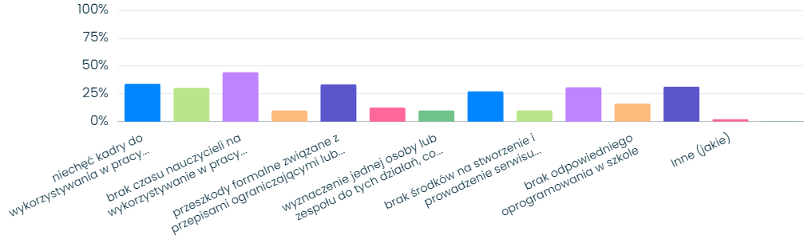
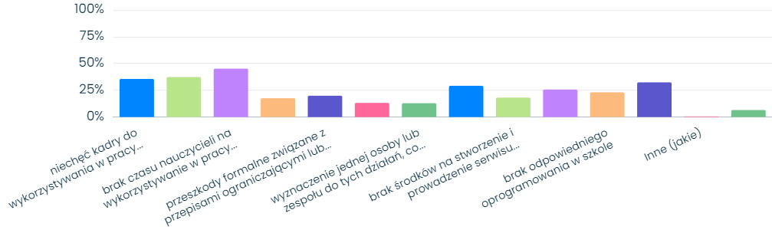
główne przeszkody występują w efektywnym wykorzystywaniu przez nauczycieli TIK w codziennym współdziałaniu z jej otoczeniem wewnętrznym (tj. uczniami i nauczycielami)?

Slide 19
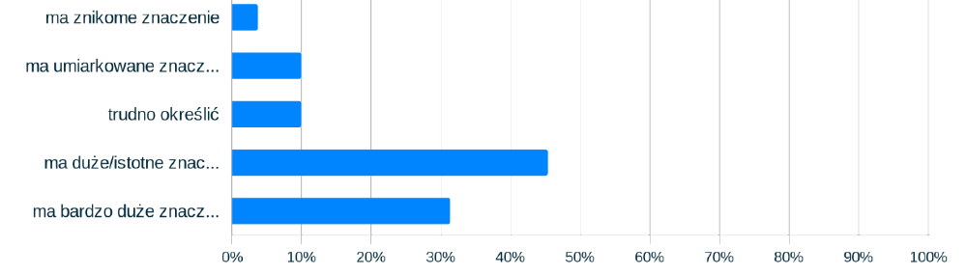
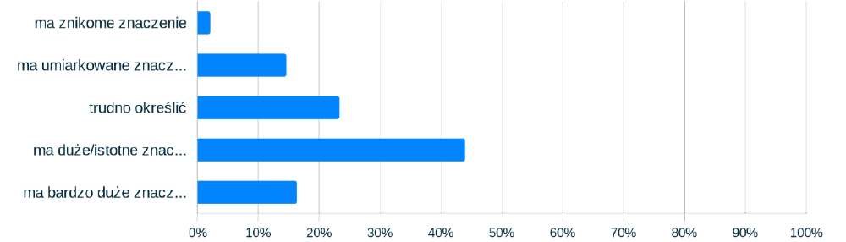
Estimating the positive impact of using ICT on the effectiveness of the educational process
It has little importance
It has moderate importance
It's hard to say
It has great importance
It has very great importance
It has little importance
It has moderate importance
It's hard to say
It has great importance
It has very great importance

Slide 20
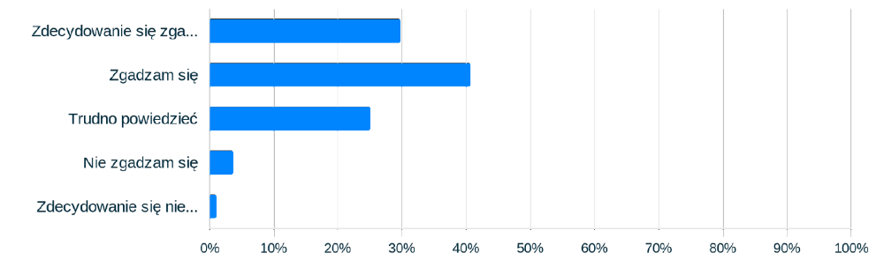
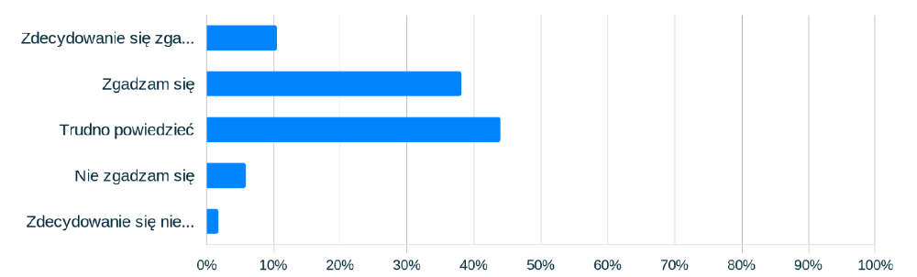
(subiektywna) ocena: nauczyciele-dydaktycy w mojej szkole mają pozytywny stosunek do wykorzystywania w procesie kształcenia technologii informacyjno-komunikacyjnych.

Slide 21
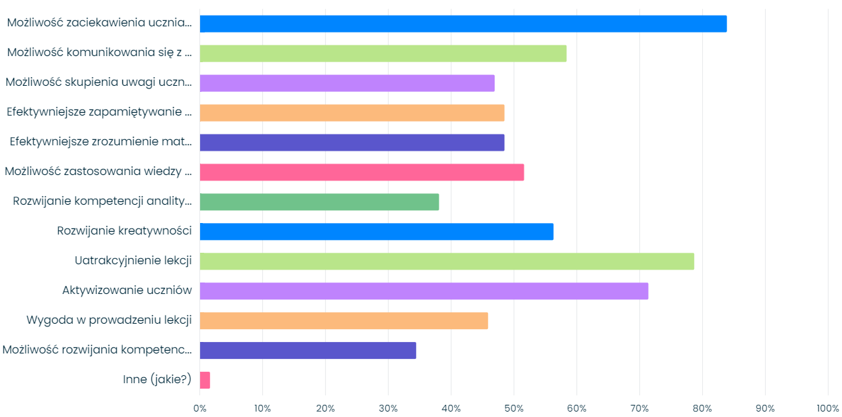
assessment of the benefits of using information and communication technologies in the educational process
Ability to engage students in the material
Ability to communicate with students
Ability to focus students' attention
More effective memorization of material
More effective understanding of material
Ability to apply knowledge in practice
Developing analytical skills
Developing creativity
Making lessons more attractive
Activating students
Ease of conducting lessons
Ability to develop students' social skills
Other (please specify)

Slide 22
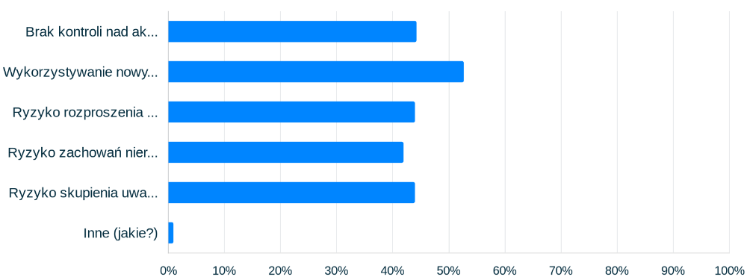
the main risks associated with the use of ICT in the educational process
Lack of control over student activity
The use of new technologies increases the abuse of the internet by YP
Risk of student distraction during classes
Risk of irregular behavior during classes (e.g., pornography, cyberbullying)
Risk of students focusing on the benefits of new technologies rather than the content of classes
Other

Slide 23
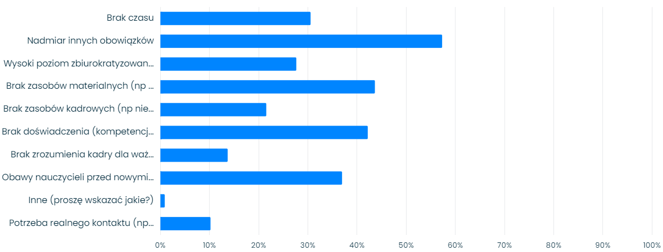

Slide 24
Key Findings
Teachers most frequently use virtual systems (e-journals) and interactive whiteboards, and least frequently use educational podcasts and foreign language learning software;
Approximately 40% of teachers use ICT frequently or very frequently in school teaching;
Public schools use digital teaching resources slightly more frequently than private institutions;
Teachers are consistent in their use of digital teaching resources, meaning those experimenting with and implementing ICT in schools do so regardless of the type of software and hardware;
Active support from principals increases the frequency of ICT use in education;
In schools where students are prohibited from using smartphones, the frequency of ICT use in education is lower.
The pandemic has not changed

Slide 25
Digital Competences of Pre-service Teachers in Italy and Poland
The aim of this research was to compare the level of digital competence of future pedagogical staff (students of pedagogical faculties) in Italy and Poland.
The research was conducted using original measurement tools and knowledge tests. The triangulation of techniques and research tools made possible the determination of the level of knowledge of the positive and negative features of the development of the information society, as well as the proficiency and frequency of use of the most popular websites and software.
N = 1209, IT = 604, PL = 605).

Slide 26
(1) Pre-service teachers most often use software such as word processors and presentation creation tools;
(2) This group very rarely uses software to create web pages, create visual material, or edit video;
(3) The least problematic software that students use are word processors and multimedia presentations;
(4) Among the typical ICT mediated activities that cause problems are: searching for and installing freeware (PL), installing and configuring parental control software (PL, IT), creating websites (PL, IT), searching for freely licensed images, and identifying plagiarism (PL);
(5) Polish students have more theoretical knowledge about e-risks and the possibilities of the digital world than their Italian counterparts;
(6) In most domains, the Italian future teachers rate their competences higher;
(7) 53.81% of the respondents in IT and 38.68% in PL received lower results in competence tests, and handling ICT in selected areas causes problems for these students;
(8) Both in PL and IT the frequency of ICT use and its seamless integration are predictors for assessing the effectiveness of ICT use in education.

Slide 27
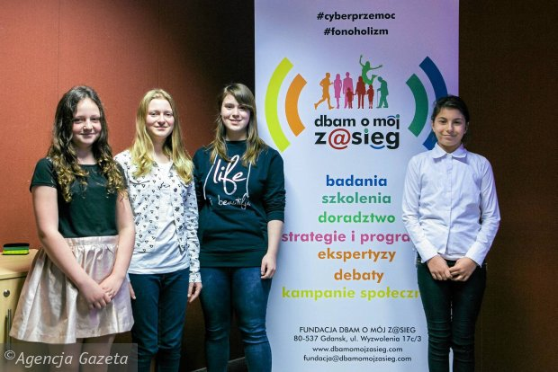
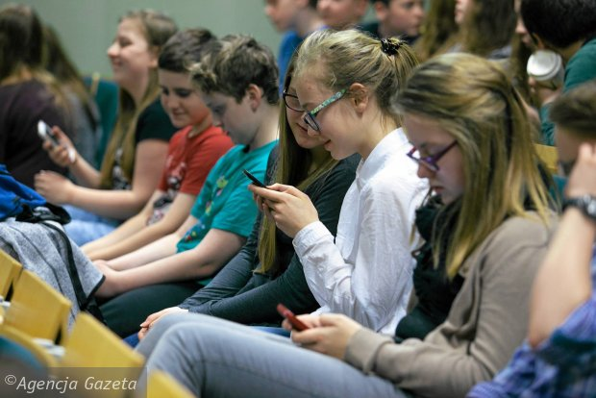
Gdynia Teenagers on a "Detox" – "Beyond the Net@" Experiment –
Sociologists from the "Dbam o mojego z@sięg" Foundation; 60 "brave young people" aged 12 to 18 undertook the heroic task of being offline for three days. The experiment is the next stage of a Gdynia-based study on youth communication behavior. Participants were asked to complete several tasks, such as creating a poster together, arranging a meeting at a specific location, using a traditional library, and so on.

Slide 28
a handful of inspiration

Slide 29

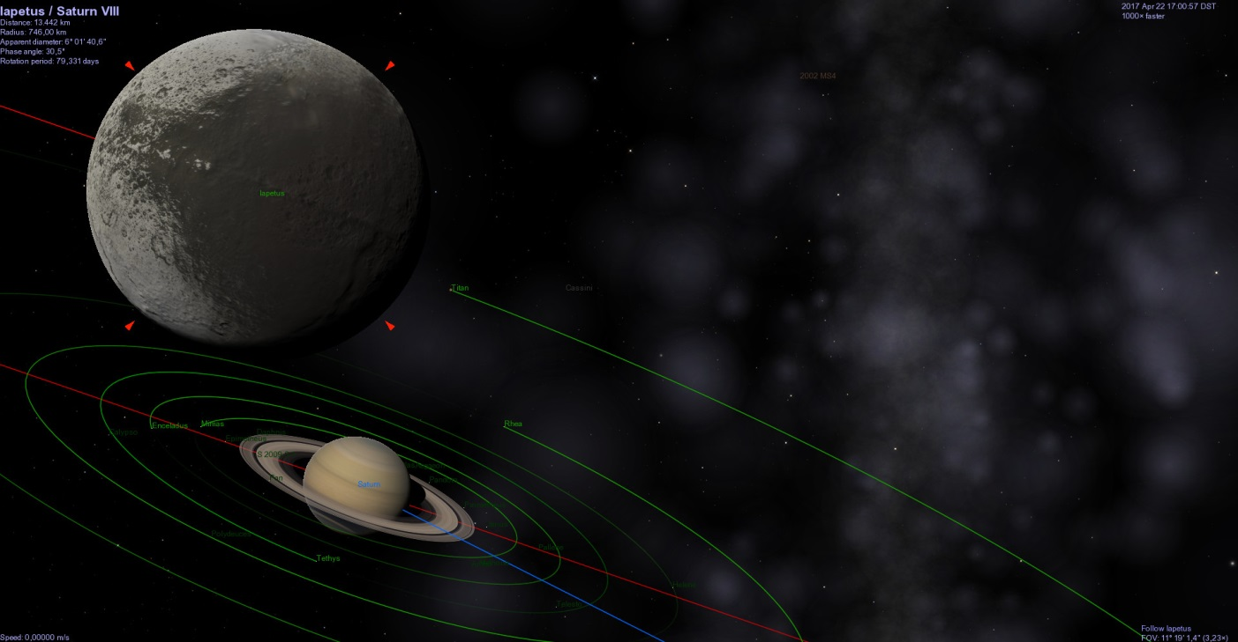
A free, 3D space simulator for Linux, OS X, and Windows, created by Chris Laurel. The program uses OpenGL libraries, providing image quality comparable to modern computer games.
#astronomy
Extensive features,
Scripting capabilities,
Easy to use

Slide 30
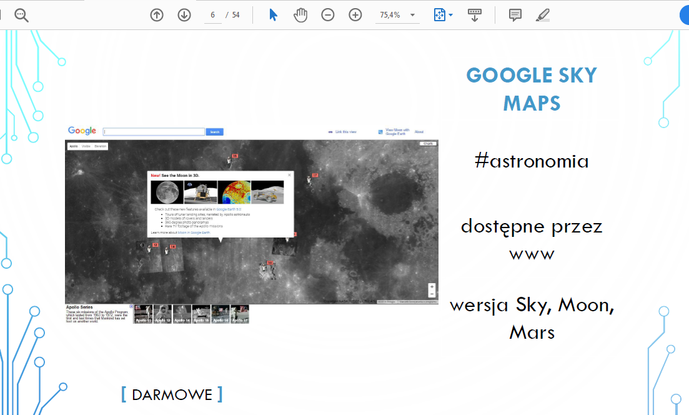

Slide 31
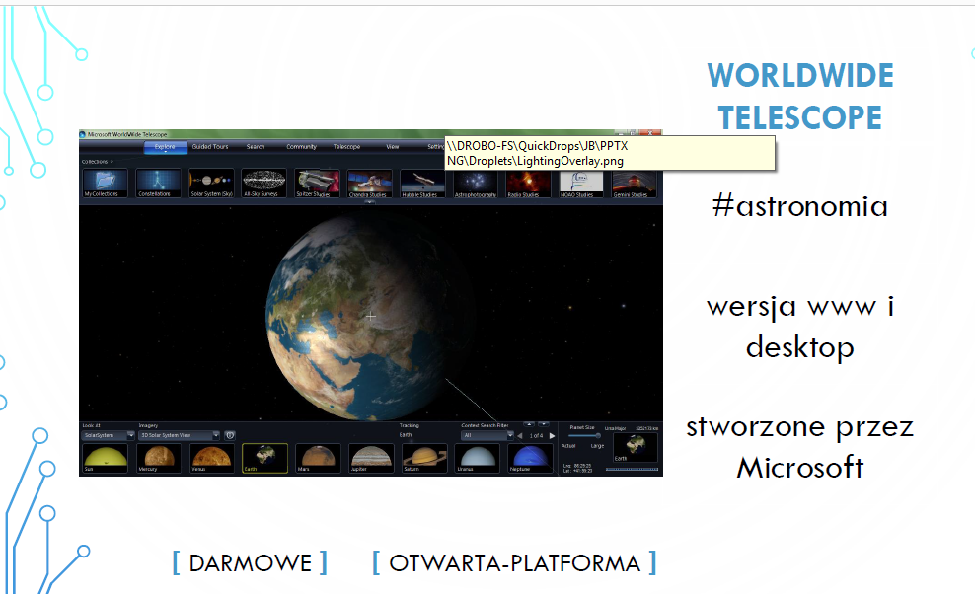

Slide 32
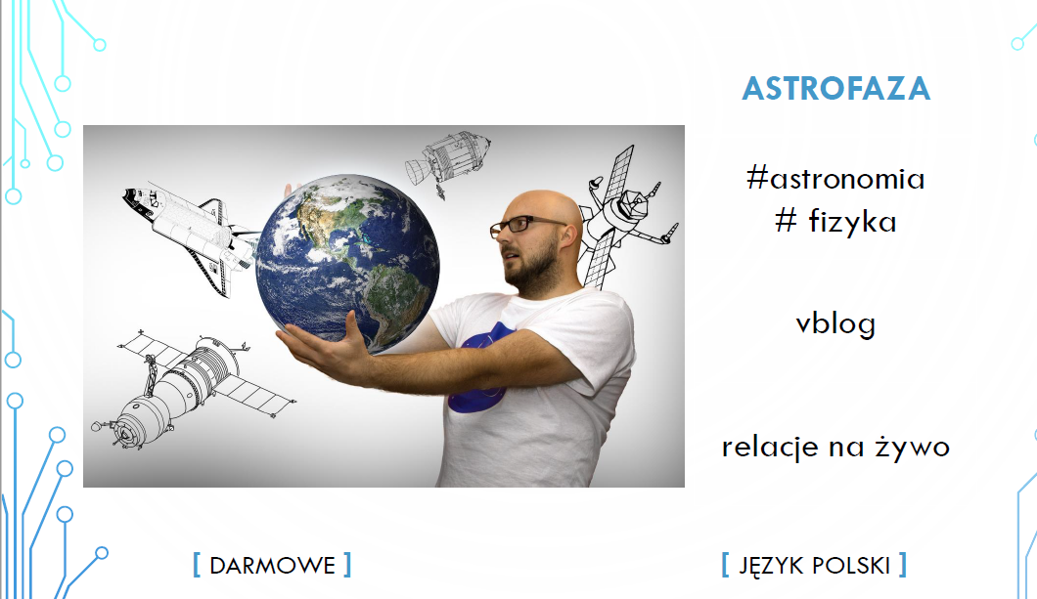

Slide 33
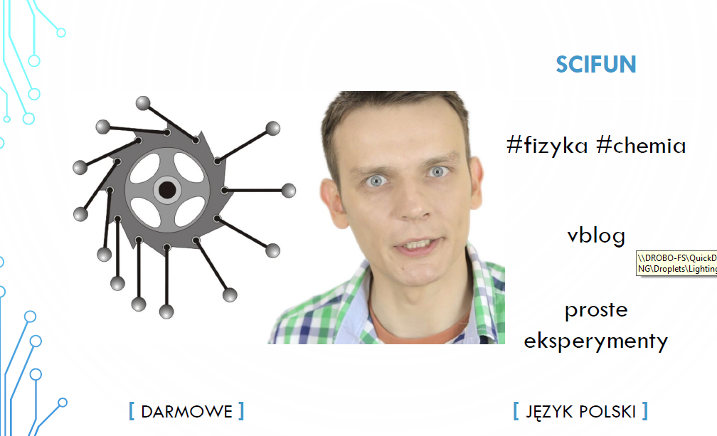

Slide 34
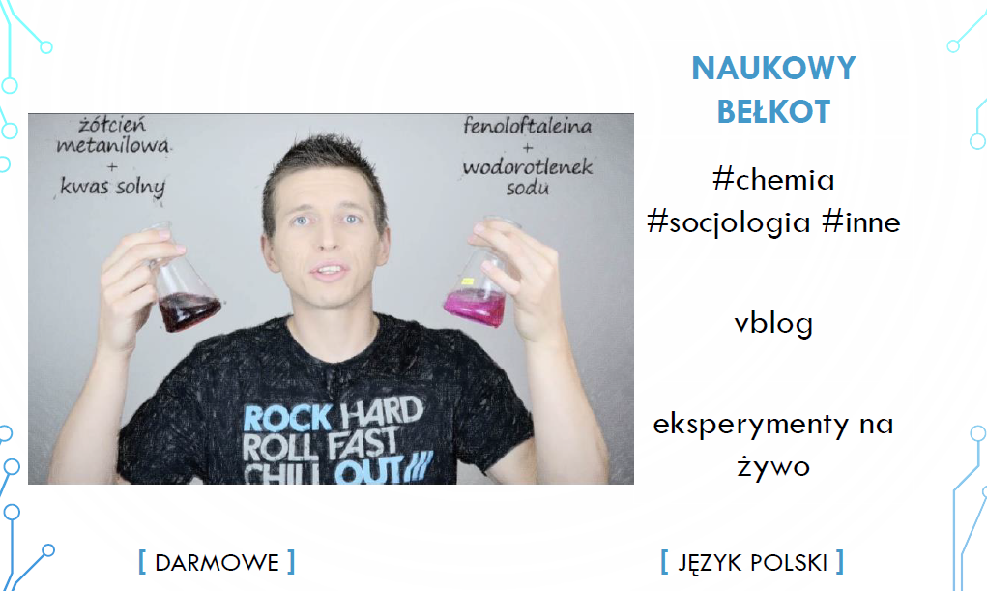

Slide 35
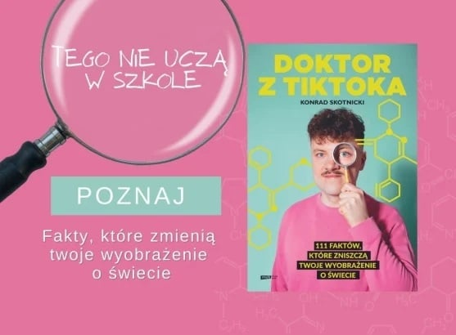

Slide 36
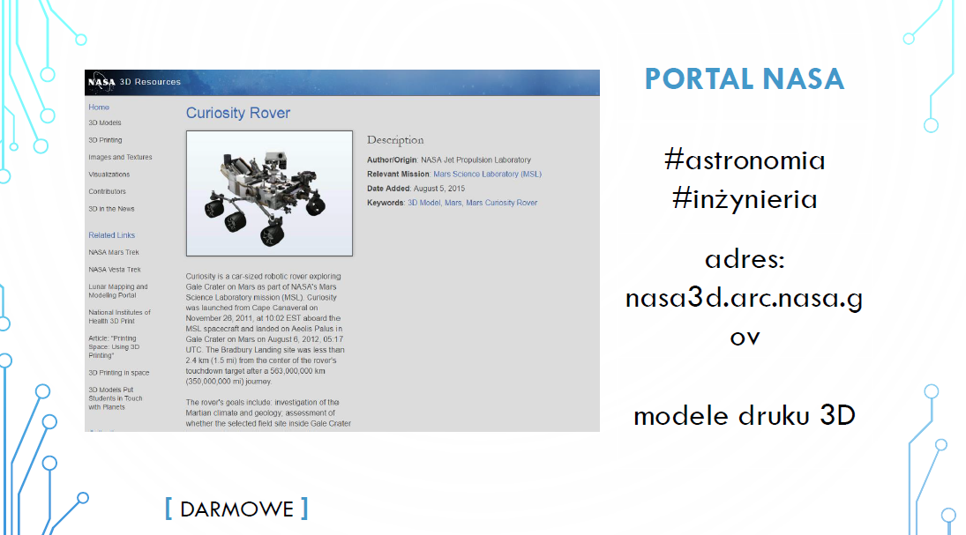

Slide 37
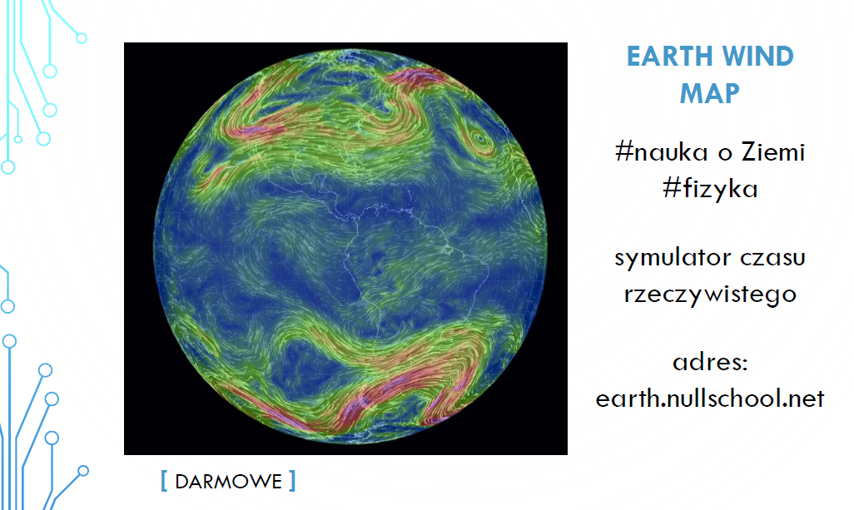

Slide 38
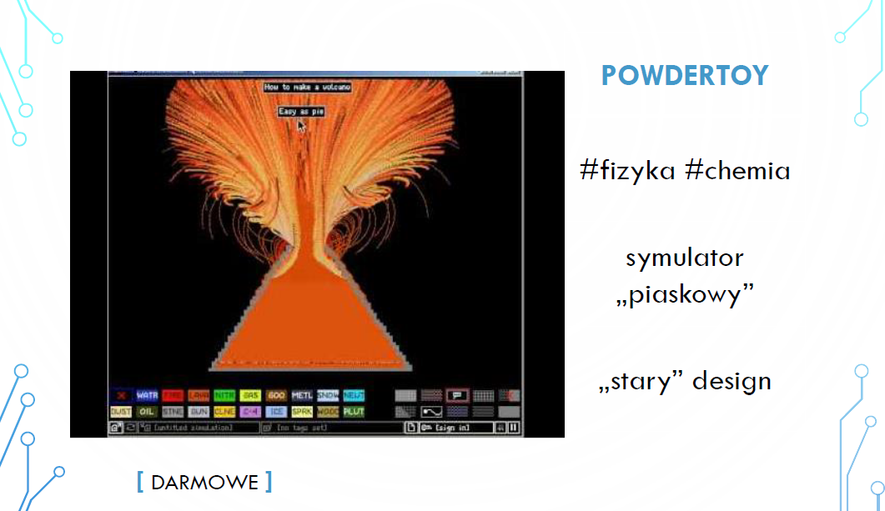

Slide 39
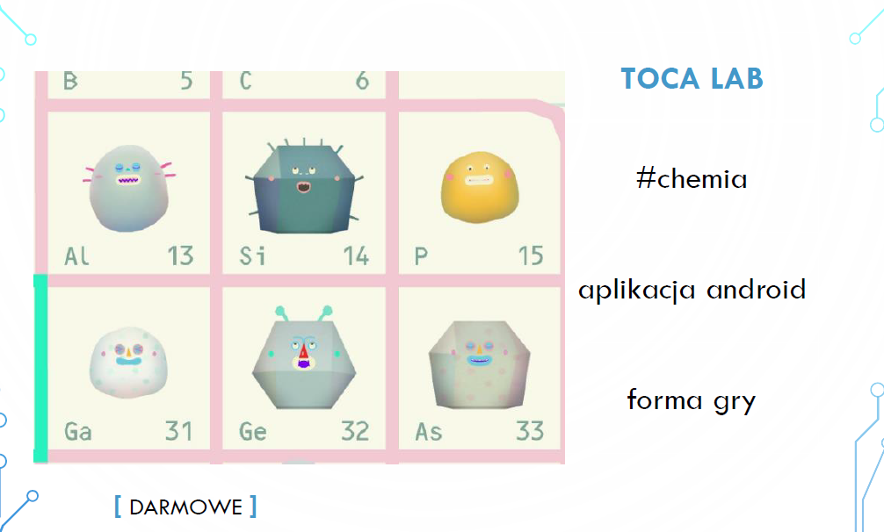

Slide 40
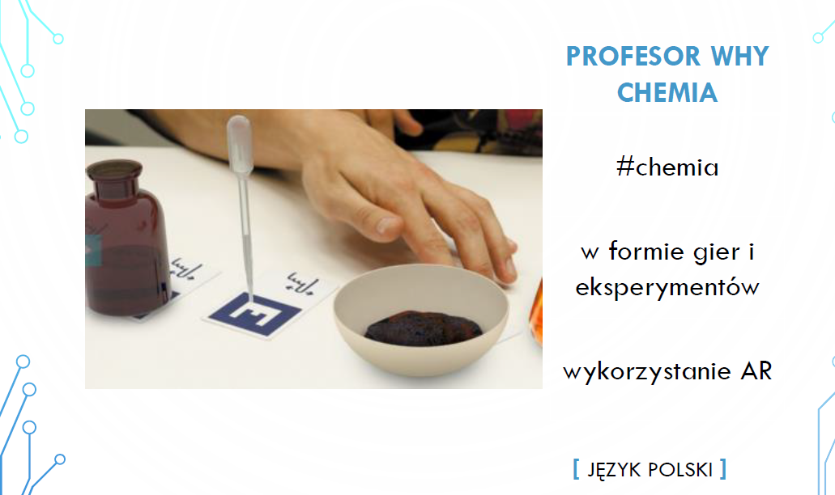

Slide 41
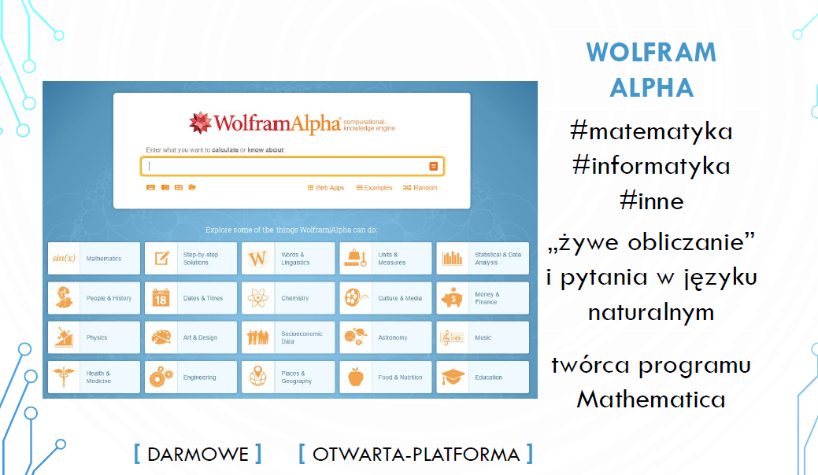

Slide 42
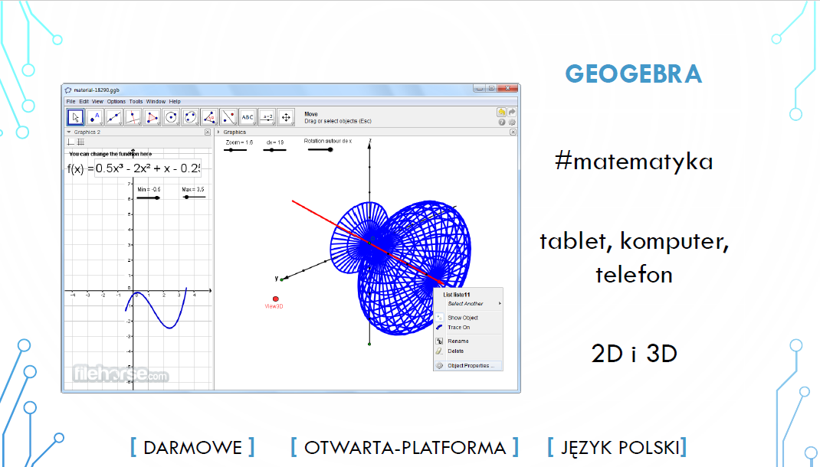

Slide 43
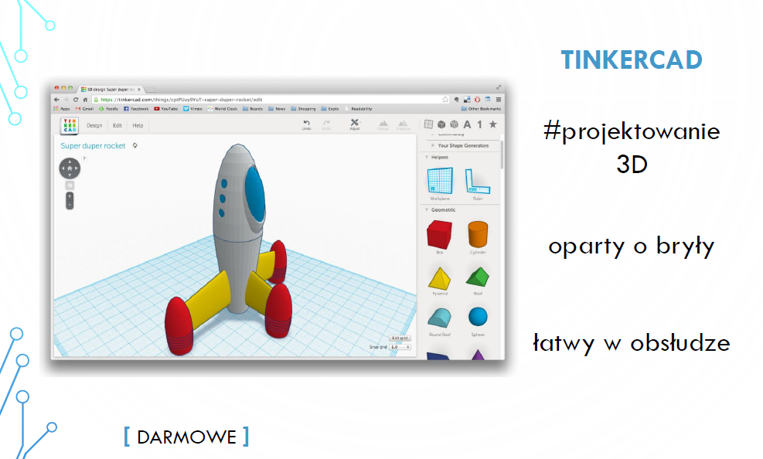

Slide 44
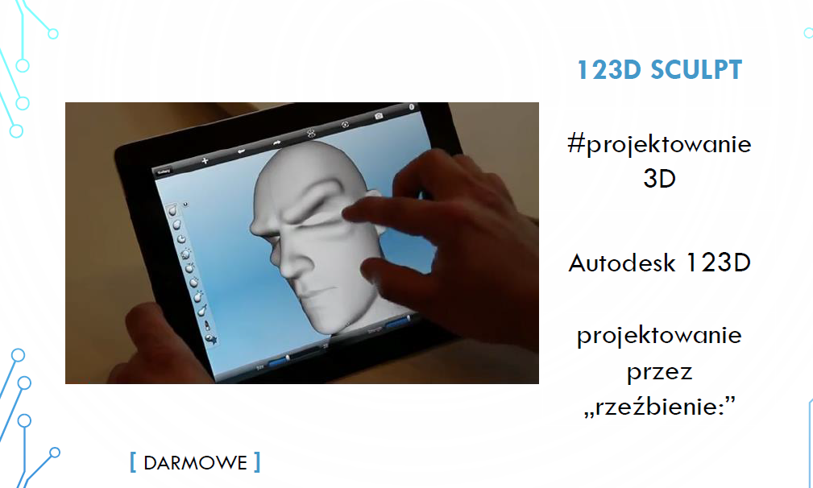

Slide 45
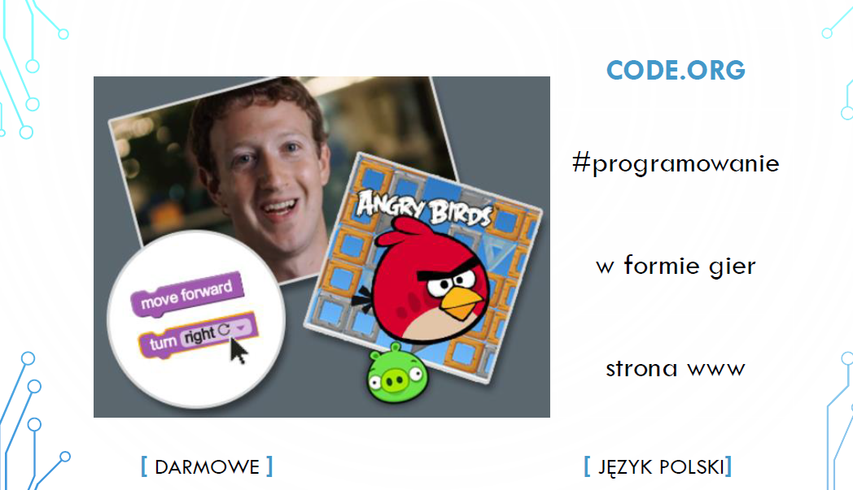

Slide 46
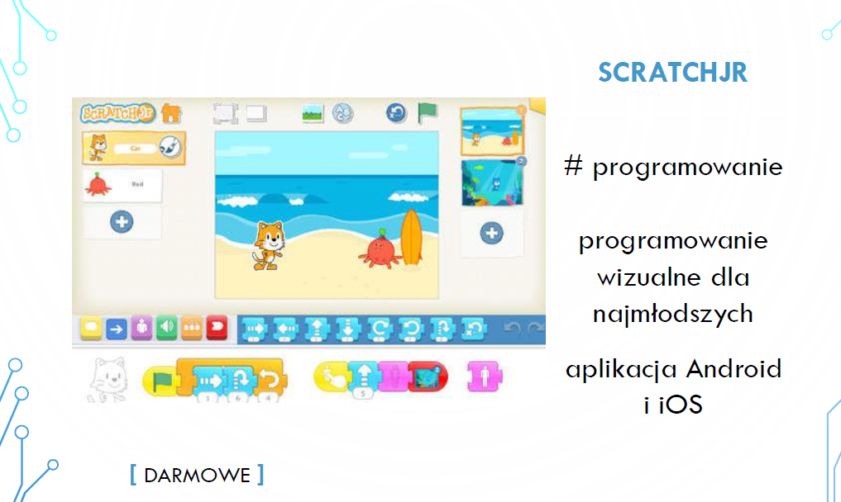

Slide 47


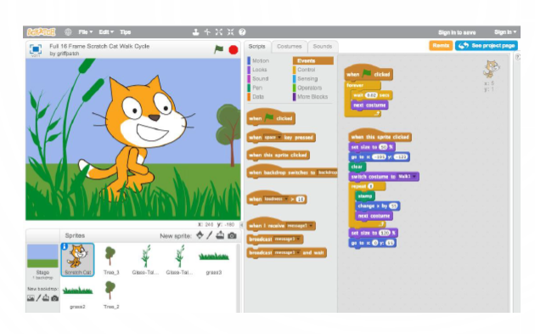

Slide 48
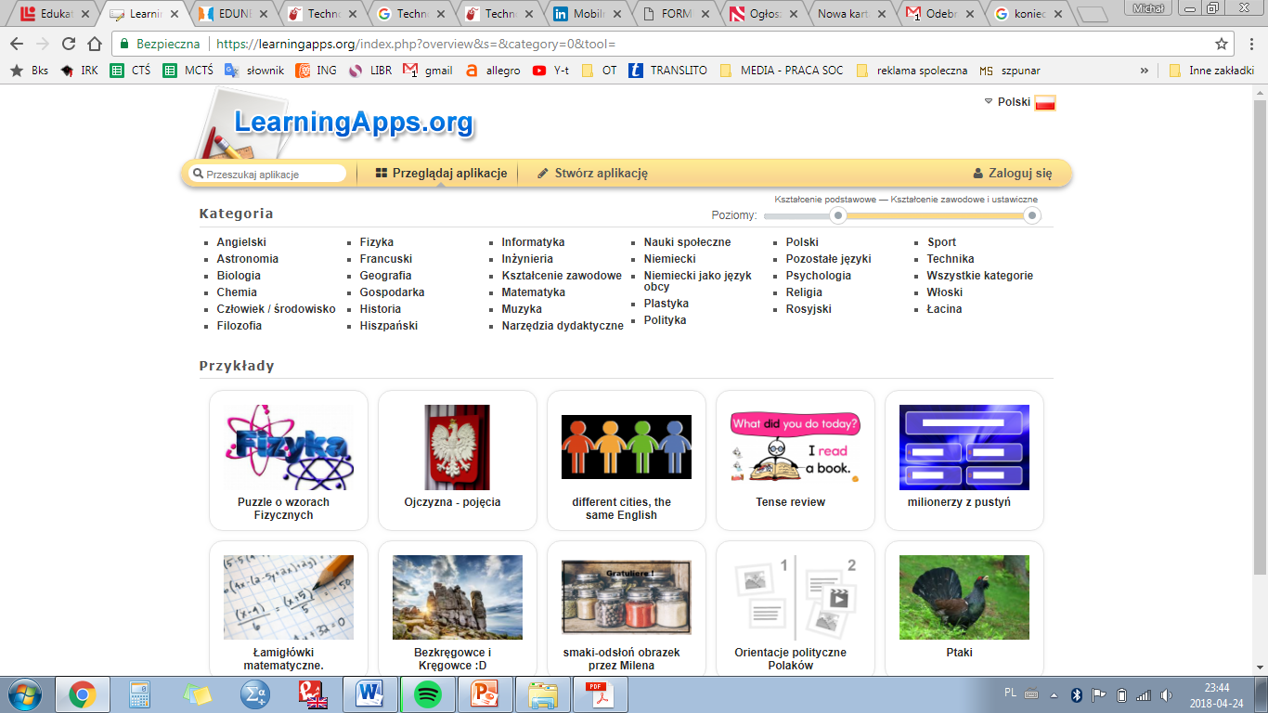

Slide 49
thank you for your attention

