Slide 1

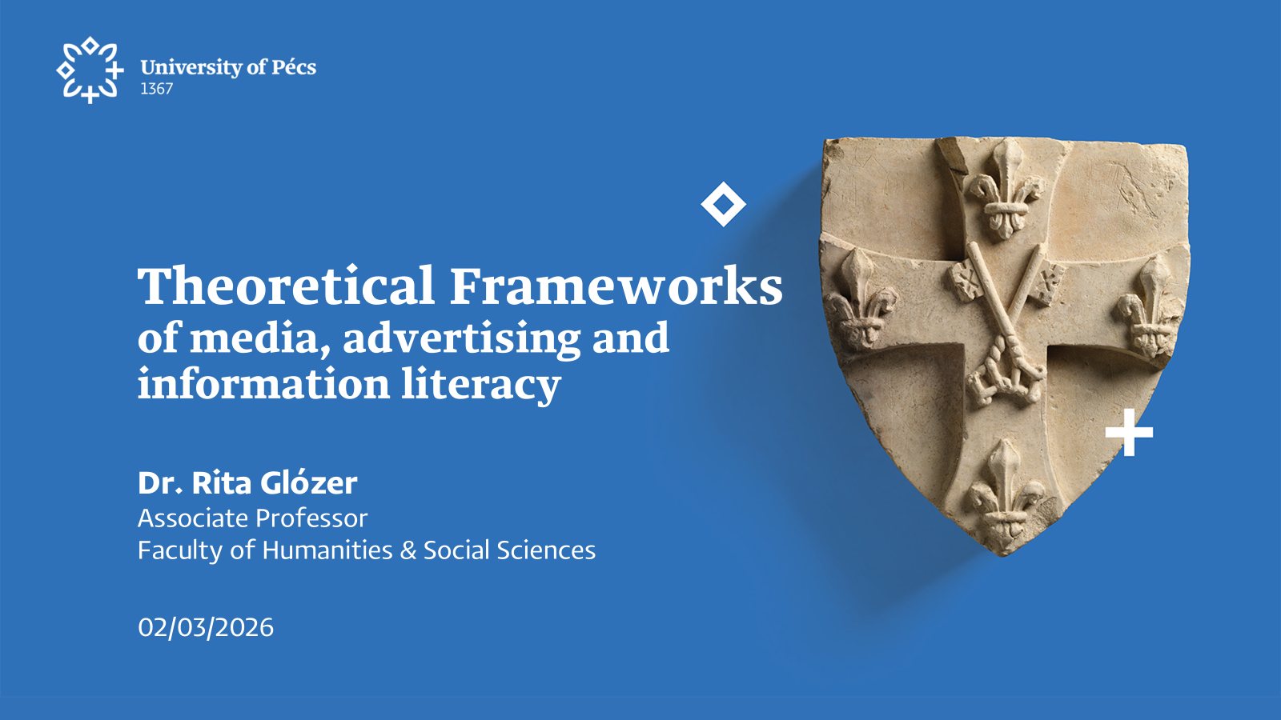

Slide 2
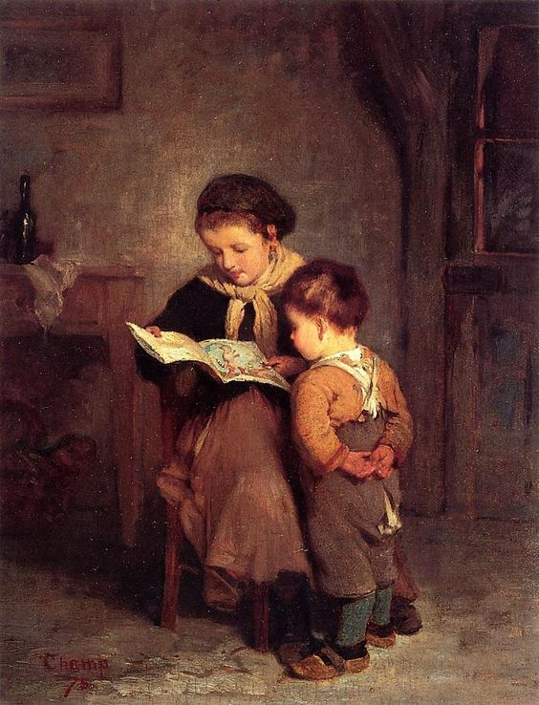
Literacy
An old concept with changing definitions
transforming culture & communication – transforming concept of literacy
written text ⇒ printed text ⇒ mass communication ⇒ digital and networked media
connection between literacy, education, social integration, and participation

Slide 3

Literacy
umbrella concept: there is no single generally accepted definition
diverse forms of reading, interpretation, and meaning-making
capacity to comprehend different kinds of signs and symbolic systems
ability to produce and communicate meanings through these systems in socially and culturally situated contexts.

Slide 4
Definitions
“social practices and conceptions of reading and writing” (Street, 1984)
“the ability to produce, understand and use texts in culturally appropriate ways” (Graddol 1993)
“the mastery of simple and practical skills which bring a profound enrichment and transformation of human thinking capabilities” (Belshaw, 2012)
“the ability to read and to understand the meanings of written or printed words” (Malmelin, 2010)
fundamental transformation of the concept of “text”: from written text to other forms (spoken, performed, sung, drawn, animated, or filmed..) = expanded meaning: challenges the traditional, narrow definitions of literacy
New conceptual frameworks are needed covering multimodality, visuality, sound, and performativity alongside written language.

Slide 5
Contemporary concepts of literacy
in networked media environments
dramatic proliferation and diversification of communicative forms, genres, and platforms
multimodal, digital, and participatory competencies are required
literacy can no longer be reduced to the interpretation and production of written texts alone
contemporary literacy = a broader set of competencies enabling individuals to navigate complex, multimodal communicative environments
emergence of multiple, partly overlapping forms of literacy, such as media literacy, information literacy, digital literacy, and advertising literacy
composition of contemporary literacy: technical ability to access and use digital tools + the critical capacity to evaluate information, understand media logics, recognise persuasive and commercial intentions, and participate meaningfully in networked public

Slide 6
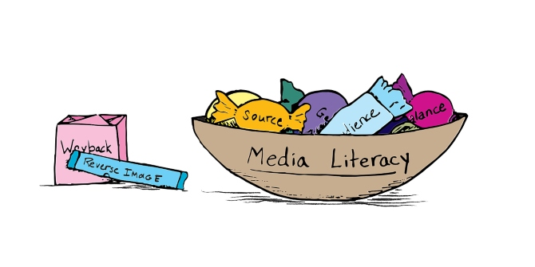
Media literacy
Study of media literacy :
interdisciplinary field: sociology, psychology, political theory, gender and race studies, cultural studies, art, aesthetics, communication studies (Duncan 2006)
multidisciplinary field: literacy, culture, media education, human-computer interaction, and social studies of technology (Livingstone, 2004)
Fields affected by the state of literacy
development of democracy, cultural participation and active citizenship (Koltai 2011),
reducing social inequalities (Park 2012)

Slide 7
Why media literacy is essential nowadays?
the emergence of post-typographic forms of text production + distribution + reception using digital media
high rate of media consumption
media deeply influences perceptions, beliefs and attitudes
a large amount and diverse information is available - in multiple media and uncertain quality
the effective use of information in society & the need for lifelong learning are acquiring more and more importance (Koltai 2011)
Growing academic and institutional interest in questions of media literacy
European Commission (2007): there is a need to build up a better understanding of how the media work in the digital world, and that citizens need to understand better the economic and cultural dimensions of media

Slide 8
Media literacy - definitions of an umbrella concept
“A media literate person – and everyone should have the opportunity to become one – can decode, evaluate, analyse and produce both print and electronic media. The fundamental objective of media literacy is a critical autonomy relationship to all media. Emphases in media literacy training range widely, including informed citizenship, aesthetic appreciation and expression, social advocacy, self-esteem, and consumer competence”. (Aufderheide, 1992)
European Commission (2007): the ability to access the media, to understand and to critically evaluate different aspects of the media and media content and to create communications in a variety of contexts
feeling comfortable with all existing media
having a critical approach to media (quality and accuracy of content)
using media creatively
understanding the media economy and the difference between pluralism and media ownership
being aware of copyright issues
AML (Ontario Association for Media Literacy) cited by Duncan 2006: media literacy “is concerned with developing an informed and critical understanding of the nature of the mass media, the techniques used by them, and the impact of these techniques” - education is crucial
Wallis and Buckingham 2013: “about learning to make informed choices: making effective use of available technologies and systems to block or filter content, as well as viewing ‘critically’ and being generally ‘aware’ of how the media work.
Park 2012: 89: “ the ability to access, analyse, evaluate and produce media content”
Malmelin 2010: 131 : “the ability to read and critically analyse different forms and means of media representation. The development of personal media literacy begins with the realisation that every day, we receive thousands of messages that can potentially influence our opinions, attitudes, values and behaviour”

Slide 9


Digital media literacy
 | Device literacy | Content literacy
Access | Device ownership, access to service | Ability to search, find and filter relevant content
Understand | Understand the basic nature of technology and know how to operate at a functional level | Ability to understand and critically analyse content
Create | Ability to produce, reproduce and create content using digital technology | Ability to form opinions, ideas and convert into digital content. Knowledge of the social impact, cyber etiquette and ethics.
Extension of media literacy in networked environments.
Active participation: create, modify, circulate content.
Device-related and content-related competencies (Park, 2012).
Second-level digital divide: skills and usage inequalities.

Slide 10

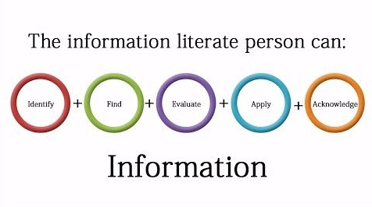
Information literacy
Recognizing information needs (ALA, 1989) &
Identifying, evaluating, and effectively using information.
Critical thinking and source credibility assessment.
Foundation of informed democratic participation.
Meta-competence integrating multiple literacies:
Access, management, evaluation, creation, communication.
Closely linked to digital divide and social inclusion.
Includes techno-ethical awareness (privacy, identity, copyright).

Slide 11
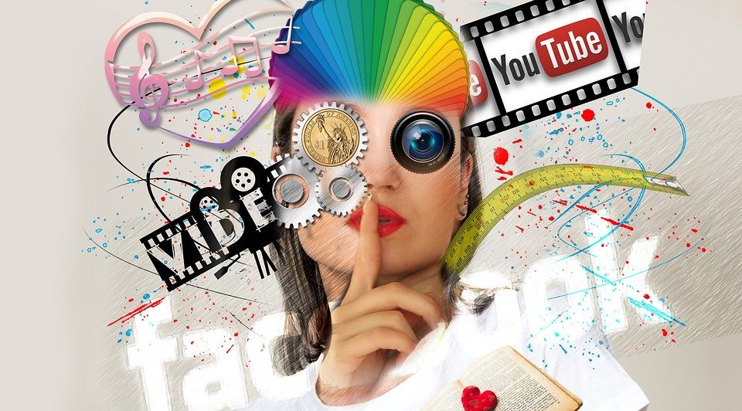
Advertising literacy

Slide 12

Advertising literacy
Subfield of media literacy focused on commercial communication.
Recognition of persuasive intent and branding strategies.
Understanding symbolic, ideological and economic dimensions.
Native advertising, influencer marketing, branded content...

Slide 13
Dimensions of advertising literacy
Dimension
Focus
Dimension | Focus | Analytical Emphasis
Informational | Sources & knowledge | Evaluation of accuracy and credibility
Visual / Aesthetic | Design & symbolism | Interpretation of visual codes
Rhetorical | Persuasion tactics | Strategies, goals, target groups
Promotional | Commercial logic | Product placement & branded content

Slide 14


