Slide 1



METHODOLOGICAL ISSUES IN ASSESSING
CRITICAL THINKING
AND SUSCEPTIBILITY TO CONSPIRACY THEORIES AMONG
OLDER ADULTS
Colloquium 3
WSB University,
Cieplaka 1c, 41-300 Dąbrowa Górnicza; Room No. 227 ‘Design thinking’
21.11.2025
PROF. KATARÍNA FICHNOVÁ, PHD¹.;
ASOC. PROF. ŁUKASZ WOJCIECHOWSKI; PHD.^{.2;}
ASOC. PROF. EDITA ŠTRBOVÁ, PHD.¹; ASOC. PROF. BLANDÍNA ŠRAMOVÁ, PHD.³
¹⁾ CONSTANTINE THE PHILOSOPHER UNIVERSITY IN NITRA, SLOVAKIA,
²⁾ UNIVERSITY OF SS. CYRIL AND METHODIUS IN TRNAVA, SLOVAKIA;
³⁾ ZLÍN, CZECH REPUBLIC
Project EÚ - Recovery and Resilience Plan of the Slovak Republic 09I03-03-V04-00666 Fellowships for Excellent Researchers R2-R4 „Potentials of creativity as a source of prophylaxis against fake news in social media“.

Slide 2
AIM
AIM
Older Adults
Crithical Thinkng
Identifying CT
WGC
Reserch Smple
Procedure
Results nd conclusion
The aim of this study is to identify the most appropriate method for identifying critical thinking in older adults (seniors).

Slide 3
THEORETICAL BACKGROUND - OLDER ADULTS
AIM
Older Adults
Crithical Thinkng
Identifying CT
WGC
Reserch Smple
Procedure
Results nd conclusion
Older respondents may:
prefer face-to-face interviews or paper questionnaires to online formats (Schneider, et al., 2022).
have ontogenetically conditioned deficits in short-term and working memory or limited concentration and communication skills,
which are likely to interfere with the process of answering questions (Salthouse, Ferrer-Caja, 2003; Kutschar, Weichbold & Osterbrink, 2019).
Kutschar, P., Weichbold, M. & Osterbrink, J. Effects of age and cognitive function on data quality of standardized surveys in nursing home populations. BMC Geriatr 19, 244 (2019). https://doi.org/10.1186/s12877-019-1258-0
Schneider, S., Junghaenel, D. U., Meijer, E., Zelinski, E. M., Jin, H., Lee, P. J., & Stone, A. A. (2022). Quality of survey responses at older ages predicts cognitive decline and mortality risk. Innovation in Aging, 6(3), igac027.
Salthouse TA, Ferrer-Caja E. What needs to be explained to account for age-related effects on multiple cognitive variables? Psychol Aging. 2003 Mar;18(1):91-110. doi: 10.1037/0882-7974.18.1.91. PMID: 12641315.

Slide 4
THEORETICAL BACKGROUND –
OLDER PEOPLE AS A VULNERABLE GROUP
AIM
Older Adults
Crithical Thinkng
Identifying CT
WGC
Reserch Smple
Procedure
Results nd conclusion
older adults was significantly associated with higher suggestibility scores (Biondi et al., 2020)
older adults tend to be more trusting on average than younger adults (Bailey & Leon, 2019)
an fMRI study - older adults exhibit reduced activity in the anterior insula — which partly explains their increased trustfulness/risk of deception (Castle et al., 2012)
Fraud targeting seniors is at an all-time high (TASR, 2025)
The most common victims are seniors aged 65 and older (930 000).
2024 – 125 frauds – 1,5 mil. €
2025 – 96 frauds (jan to june) – mor than 1 mil €
Biondi, S., Mazza, C., Orrù, G., Monaro, M., Ferracuti, S., Ricci, E., … Roma, P. (2020). Interrogative suggestibility in the elderly. PLOS ONE, 15(11), e0241353. https://doi.org/10.1371/journal.pone.0241353
Bailey, P. E., & Leon, T. (2019). A systematic review and meta-analysis of age-related differences in trust. Psychology and Aging, 34(5), 674–685. https://doi.org/10.1037/pag0000368
Castle, E., Eisenberger, N. I., Seeman, T. E., Moons, W. G., Boggero, I. A., Grinblatt, M. S., & Taylor, S. E. (2012). Neural and behavioral bases of age differences in perceptions of trust. Proceedings of the National Academy of Sciences of the United States of America, 109(51), 20848–20852. https://doi.org/10.1073/pnas.1218518109
Správa o kriminalite páchanej na senioroch.[Report on crimes committed against seniors] https://www.employment.gov.sk/files/slovensky/ministerstvo/rada-vlady-sr-prava-seniorov/zasadnutie-23-11.2015/bod-c.1/material-k-bodu-c-1-mv-sr.pdf, 11 s.
TASR. August 21 2025. https://www.sme.sk/domov/c/podvodov-zacielenych-na-seniorov-je-najviac-v-historii

Slide 5
THEORETICAL BACKGROUND - CRITICAL THINKING
AIM
Older Adults
Crithical Thinkng
Identifying CT
WGC
Reserch Smple
Procedure
Results nd conclusion
... the process of actively, vigilantly, and systematically considering information, ideas, and claims in order to arrive at reasoned conclusions and decisions.
It includes the following skills:
Analyzing facts, evidence, observations, and arguments.
Evaluating the credibility of sources and the validity of arguments.
Synthesizing (combining) different pieces of information and ideas into a coherent understanding.
Interpret data and texts and determine their true meaning.
Justify your own conclusions and be able to defend them.
(Facione, 1990; Paul & Elder, 2019; Demir, 2015; Gonsalves, 2024)
Demir, Sibel. Ä2015). Evaluation of Critical Thinking and Reflective Thinking Skills among Science Teacher Candidates. In: Journal of Education and Practice. 2015, vol. 6, no. 18, pp. 17 – 21
Facione, P. A. (1990). Critical Thinking: A Statement of Expert Consensus for Purposes of Educational Assessment and Instruction. Millbrae: The California Academic Press.
Gonsalves, A. I. 2024. Generative AI’s impact on critical thinking: Revisiting Bloom’s taxonomy. https://doi.org/10.1177/02734753241305980.
Paul, R., & Elder, L. (2019). The miniature guide to critical thinking concepts and tools. Dillon Beach, CA: Foundation for Critical Thinking https://www.criticalthinking.org/files/Concepts_Tools.pdf

Slide 6
TYPES OF METHODS
FOR IDENTIFYING THE LEVEL OF CRITICAL THINKING
AIM
Older Adults
Crithical Thinkng
Identifying CT
WGC
Reserch Smple
Procedure
Results nd conclusion
SELF-ASSESSMENT METHODS (INDIRECT ASSESSMENT)
PERFORMANCE EVALUATION (DIRECT EVALUATION)
Critical Thinking Disposition Scale (Sosu, 2013; Bravo et al., 2021)
was assumed to assess two dimensions: ‘critical openness’ (7 items) and ‘reflective skepticism” (4 items). Scores from the 11 items can be added up to obtain a total score, ranging from 11 to 55.
Thinking Skills Assessment (TSA) The University of Cambridge ((UCLES, 2015) Summarising the main conclusion, drawing a conclusion, identifying an assumption, assessing the impact of additional evidence, detecting reasoning errors, matching arguments and applying principles. 25 items.
Rational-Experiential Inventory (REI) Pacini and Epstein, 1999): 40 items, two main scales: Rationality (20 items) and Experientiality (20 items).
Critical Thinking Test (CTT) The CTT contains 36 questions (Hanzlova, R., & Kudrnáč, A. (2024), originality 40 (Sustekova et al., 2019; Vašek, 2016).
Hanzlova, R., & Kudrnáč, A. (2024). Developing critical thinking test for adolescents: A validity and reliability study from the Czech Republic. Thinking Skills and Creativity, 53, 101613.
Sosu, E. M. (2013). The development and psychometric validation of a critical thinking disposition scale. Think. Skills Creativity 9, doi: 10.1016/j.tsc.2012.09.002
Bravo, MJ., Galiana, L., Rodrigo, M.F., Navarro-Pérez, J.J. & Oliver, A. (2021). An adaptation of the Critical Thinking Disposition Scale in Spanish youth, Thinking Skills & Creativity, https://doi.org/10.1016/j.tsc.2020.100748
Pacini, R., Muir, F., & Epstein, S. (1998). Depressive realism from the perspective of cognitive-experiential self-theory. Journal of Personality and Social Psychology, 74, 1056-1068.
Notes:
Štýly myslenia boli hodnotené pomocou Rational-EXperiential Inventory (REI; Pacini & Epstein, 1999).
Obe stupnice
majú 20 položiek v päťbodovej stupnici Likertovho typu (od 1 = rozhodne nesúhlasím po 5 = rozhodne súhlasím). EXample z oboch stupníc sú:
"Baví ma riešiť problémy, ktoré si vyžadujú starostlivú logickú analýzu" (analytické myslenie) a "Rád sa spolieham na svoje intuitívne dojmy (intuitívne myslenie). Španielska verzia tejto stupnice preukázala dobré psychometrické vlastnosti (Pen ̃arroja et al., 2017, S'anchez et al., 2012; Witteman et al., 2009). Cronbachove alfy v tejto štúdii boli 0,876 s CI 95 % (0,856, 0,894) pre racionálne myslenie a 0,859 s CI 95 % (0,856, 0,894) pre intuitívne myslenie vo vzorke vysokoškolských študentov.
Pacini, R., & Epstein, S. (1999). The relation of rational and experiential information processing styles to personality, basic beliefs, and the ratio-bias phenomenon. Journal of Personality and Social Psychology, 76(6), 972–987.
The Critical Thinking Disposition Scale CTDS
Španielska adaptácia CTDS a pokyny na bodovanie sú uvedené v prílohe A. (11 položiek). Údaje boli získané počas pravidelnej výučby, v akademických rokoch 2017 – 2018 a 2018 2019.
Táto váha je 11-položková, päť-bod Stupnica Likertovho typu (v rozmedzí od 1 = rozhodne nesúhlasím do 5 = rozhodne súhlasím). Pôvodne sa predpokladalo, že CTDS bude hodnotiť Rozmery: "kritická otvorenosť" (7 položiek) a "reflexívny skepticizmus" (4 položky). Skóre z 11 položiek je možné sčítať, aby ste získali celkový počet skóre v rozmedzí od 11 do 55.

Slide 7





WATSON-GLASER CRITICAL THINKING - TEST
AIM
Older Adults
Crithical Thinkng
Identifying CT
WGC
Reserch Smple
Procedure
Results nd conclusion
POLAND
0
SLOVAK REPUBLIC
80-items version/Form C
Watson, G., & Glaser, E. M.: Test hodnotenia kritického myslenia. Forma C. Bratislava: Psychodiagnostika, 2000
WGCTT
HUNGARY
0
CZECH REPUBLIC
Notes:
https://en.practest.com.pl/tests

Slide 8
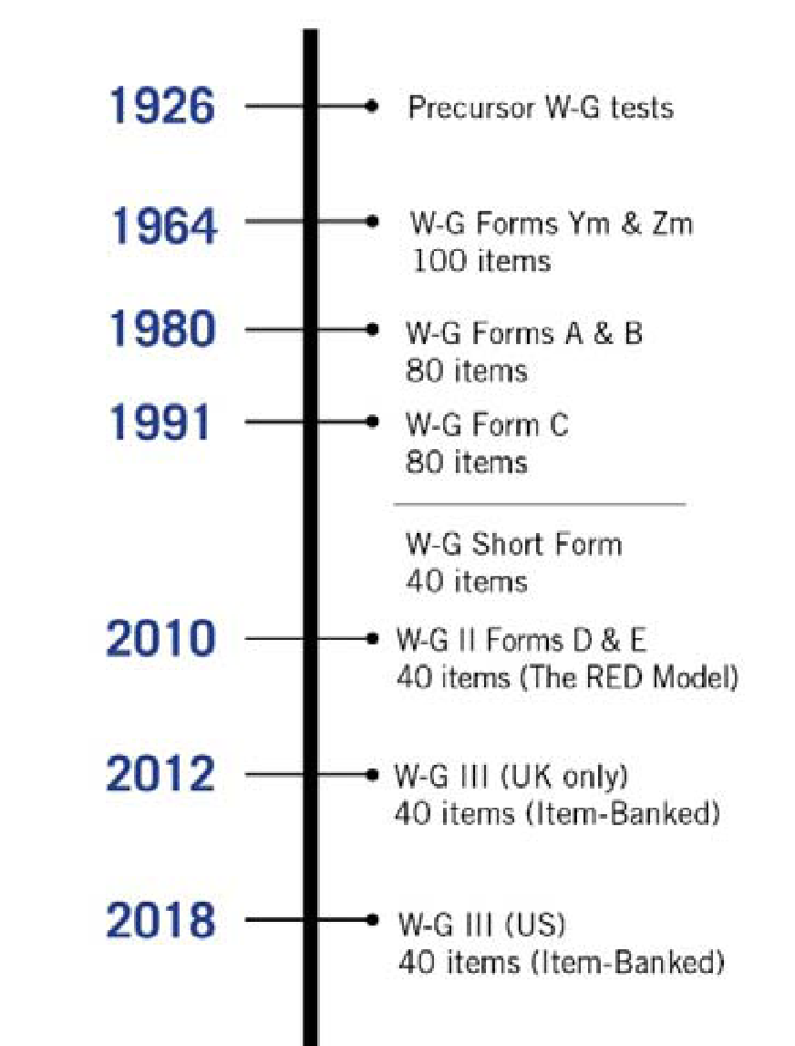
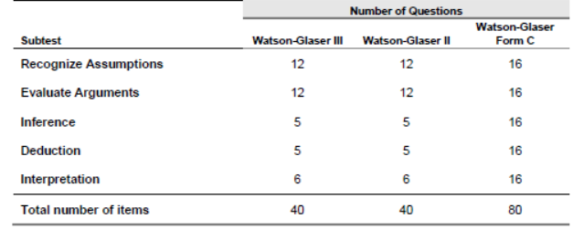
TMELINE 1 AND TABLE 1:
WATSON-GLASER™ III CRITICAL THINKING - TEST CONFIGURATION BY ITEM TYPE
AIM
Older Adults
Crithical Thinkng
Identifying CT
WGC
Reserch Smple
Procedure
Results nd conclusion
Source: Watson-Glaser™ III Critical Thinking Appraisal User's Guide and Technical Manual Goodwin Watson and Edward M. Glaser, 2018, s. 23

Slide 9
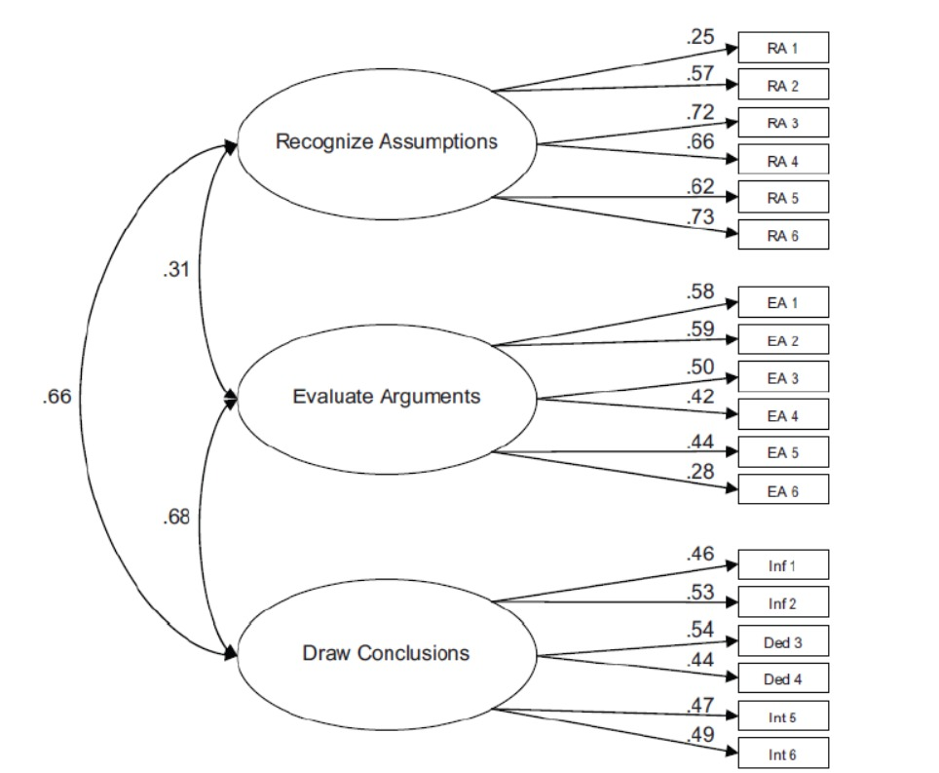
SCHEME 1: THREE-FACTOR MODEL FOR SUBTESTS AND TESTLETS (N = 306)
AIM
Older Adults
Crithical Thinkng
Identifying CT
WGC
Reserch Smple
Procedure
Results nd conclusion
Source: Watson-Glaser™ III Critical Thinking Appraisal User's Guide and Technical Manual Goodwin Watson and Edward M. Glaser, 2018, s. 23

Slide 10
RESEARCH SAMPLE
AIM
Older Adults
Crithical Thinkng
Identifying CT
WGC
Reserch Smple
Procedure
Results nd conclusion
Age 22,83, sd 1,82, min. 19, max. 36
N=158
Females N_{ž}=121
Males N_{M}=37
Students: UKF Nitra, UCM Trnava, UK Bratislava
Fields: Marketing Communication (MK), Media Communication (KOMU), Digital Games (TEDI), Journalism (ŽU)

Slide 11
PROCEDURE
AIM
Older Adults
Crithical Thinkng
Identifying CT
WGC
Reserch Smple
Procedure
Results nd conclusion
Mean, standard deviation
Modified short version of the test for seniors
  Evaluation of internal consistency of the test
  Reliability Statistics for each factor
  Cronbach's Alpha if Item Deleted
  Corrected Item-Total Correlation
  Identification of average performance for each item
  8 items
Recognition of assumptions
Evaluation of Arguments
Deductions
Interpretations
Split-half method
Item Statistic

Slide 12
RESULTS
TABLE 2: FACTOR "JUDGMENT" – PSYCHOMETRIC PROPERTIES OF W-GT (T-186, 2000).
AIM
Older Adults
Crithical Thinkng
Identifying CT
WGC
Reserch Smple
Procedure
Results nd conclusion
JUDGERENT | Scale Mean if Item Deleted | Scale Variance if Item Deleted | Corrected Item-Total Correlation | Squared Multiple Correlation | Cronbach's Alpha if Item Deleted |  |  | Mean | Std. Deviation | N
U1 | 6,5759 | 4,016 | 0,33 | 0,222 | 0,215 |  | U13 | 0,1646 | 0,37196 | 158
U15 | 6,4114 | 4,155 | 0,251 | 0,171 | 0,244 |  | U16 | 0,1646 | 0,37196 | 158
U10 | 6,3418 | 4,214 | 0,235 | 0,244 | 0,252 |  | U11 | 0,3101 | 0,46402 | 158
U7 | 6,5443 | 4,224 | 0,215 | 0,183 | 0,258 |  | U14 | 0,3481 | 0,47788 | 158
U8 | 6,5823 | 4,283 | 0,19 | 0,136 | 0,268 |  | U5 | 0,3544 | 0,47986 | 158
U3 | 6,5759 | 4,437 | 0,111 | 0,077 | 0,296 |  | U4 | 0,3734 | 0,48525 | 158
U2 | 6,1392 | 4,643 | 0,085 | 0,126 | 0,305 |  | U8 | 0,3987 | 0,49119 | 158
U13 | 6,8165 | 4,66 | 0,07 | 0,15 | 0,309 |  | U1 | 0,4051 | 0,49247 | 158
U4 | 6,6076 | 4,546 | 0,063 | 0,066 | 0,313 |  | U3 | 0,4051 | 0,49247 | 158
U12 | 6,5696 | 4,54 | 0,06 | 0,213 | 0,314 |  | U12 | 0,4114 | 0,49365 | 158
U5 | 6,6266 | 4,656 | 0,012 | 0,093 | 0,329 |  | U6 | 0,4177 | 0,49475 | 158
U9 | 6,2405 | 4,719 | -0,001 | 0,143 | 0,331 |  | U7 | 0,4367 | 0,49756 | 158
U11 | 6,6709 | 4,706 | -0,006 | 0,123 | 0,334 |  | U15 | 0,5696 | 0,4967 | 158
U14 | 6,6329 | 4,705 | -0,011 | 0,103 | 0,337 |  | U10 | 0,6392 | 0,48175 | 158
U6 | 6,5633 | 4,706 | -0,019 | 0,159 | 0,341 |  | U9 | 0,7405 | 0,43975 | 158
U16 | 6,8165 | 4,992 | -0,132 | 0,1 | 0,36 |  | U2 | 0,8418 | 0,36611 | 158
Statement 1 Teacher... Dickens film | 1 to 6 | 6 items | U1
Statement 2 The first newspaper in Fr | 7 to 11 | 5 items | U10
Statement 3 Farm ownership | 12 to 16 | 5 items | U15

Slide 13
TABLE 4: FACTOR "RECOGNITION OF ASSUMPTIONS" –
– PSYCHOMETRIC PROPERTIES OF W-GT (T-186, 2000).
AIM
Older Adults
Crithical Thinkng
Identifying CT
WGC
Reserch Smple
Procedure
Results nd conclusion
Item Statistics |  |  |  |  | Item-Total Statistics
Recognition of assumptions | Mean | Std. Deviation | N |  |  | Scale Mean if Item Deleted | Scale Variance if Item Deleted | Corrected Item-Total Correlation | Squared Multiple Correlation | Cronbach's Alpha if Item Deleted
RD17 | 0,7261 | 0,44738 | 157 |  | RD30 | 10,0510 | 3,600 | 0,346 |  | 0,226
RD18 | 0,5223 | 0,50110 | 157 |  | RD18 | 10,2675 | 3,633 | 0,255 |  | 0,251
RD19 | 0,7834 | 0,41322 | 157 |  | RD19 | 10,0064 | 3,801 | 0,248 |  | 0,264
RD20 | 0,6178 | 0,48747 | 157 |  | RD23 | 9,9236 | 3,994 | 0,192 |  | 0,289
RD21 | 0,8917 | 0,31173 | 157 |  | RD28 | 9,9873 | 3,923 | 0,183 |  | 0,286
RD22 | 0,4968 | 0,50159 | 157 |  | RD29 | 10,1338 | 3,822 | 0,174 |  | 0,284
RD23 | 0,8662 | 0,34148 | 157 |  | RD27 | 10,0255 | 3,922 | 0,159 |  | 0,292
RD24 | 0,1592 | 0,36707 | 157 |  | RD25 | 9,9809 | 3,980 | 0,150 |  | 0,296
RD25 | 0,8089 | 0,39441 | 157 |  | RD26 | 10,0701 | 3,937 | 0,130 |  | 0,301
RD26 | 0,7197 | 0,45056 | 157 |  | RD17 | 10,0637 | 4,009 | 0,091 |  | 0,314
RD27 | 0,7643 | 0,42577 | 157 |  | RD22 | 10,2930 | 3,978 | 0,071 |  | 0,322
RD28 | 0,8025 | 0,39935 | 157 |  | RD21 | 9,8981 | 4,272 | 0,003 |  | 0,335
RD29 | 0,6561 | 0,47654 | 157 |  | RD31 | 10,0701 | 4,219 | -0,027 |  | 0,352
RD30 | 0,7389 | 0,44067 | 157 |  | RD20 | 10,1720 | 4,246 | -0,055 |  | 0,366
RD31 | 0,7197 | 0,45056 | 157 |  | RD32 | 10,2739 | 4,380 | -0,123 |  | 0,391
RD32 | 0,5159 | 0,50135 | 157 |  | RD24 | 10,6306 | 4,529 | -0,187 |  | 0,385
Reliability Statistics
Cronbach's Alpha | Cronbach's Alpha Based on Standardized Items | N of Items
0,326 | 0,329 | 16
STATEMENT 1 | 17- 18 | 2 items | RD18
STATEMENT 2 | 19 - 21 | 3 items | RD19
STATEMENT 3 | 22 - 24 | 3 items
STATEMENT 4 | 25 - 27 | 3 items
STATEMENT 5 | 28 - 30 | 3 items | RD30
STATEMENT 6 | 31 - 32 | 2 items

Slide 14
TABLE 5: FACTOR "EVALUATION OF ARGUMENTS" - – PSYCHOMETRIC PROPERTIES OF W-GT (T-186, 2000).
AIM
Older Adults
Crithical Thinkng
Identifying CT
WGC
Reserch Smple
Procedure
Results nd conclusion
Item Statistics |  |  |  |  | Item-Total Statistics
EVALUATION OF ARGUMENTS | Mean | Std. Deviation | N |  |  | Scale Mean if Item Deleted | Scale Variance if Item Deleted | Corrected Item-Total Correlation | Squared Multiple Correlation | Cronbach's Alpha if Item Deleted
A65 | 0,6582 | 0,47581 | 158 |  | A67 | 9,8608 | 5,063 | 0,334 | 0,221 | 0,395
A66 | 0,7975 | 0,40316 | 158 |  | A71 | 9,7975 | 5,194 | 0,312 | 0,184 | 0,405
A67 | 0,7468 | 0,43621 | 158 |  | A79 | 9,9241 | 5,052 | 0,305 | 0,227 | 0,400
A68 | 0,7152 | 0,45276 | 158 |  | A78 | 9,9177 | 5,082 | 0,292 | 0,228 | 0,403
A69 | 0,7975 | 0,40316 | 158 |  | A66 | 9,8101 | 5,238 | 0,276 | 0,234 | 0,412
A70 | 0,7532 | 0,43254 | 158 |  | A80 | 10,0127 | 5,108 | 0,251 | 0,150 | 0,412
A71 | 0,8101 | 0,39345 | 158 |  | A70 | 9,8544 | 5,335 | 0,193 | 0,159 | 0,429
A72 | 0,3354 | 0,47365 | 158 |  | A76 | 9,9873 | 5,286 | 0,172 | 0,248 | 0,433
A73 | 0,5443 | 0,49962 | 158 |  | A68 | 9,8924 | 5,371 | 0,159 | 0,228 | 0,437
A74 | 0,6456 | 0,47986 | 158 |  | A74 | 9,9620 | 5,362 | 0,143 | 0,304 | 0,441
A75 | 0,6139 | 0,48840 | 158 |  | A69 | 9,8101 | 5,505 | 0,127 | 0,117 | 0,444
A76 | 0,6203 | 0,48687 | 158 |  | A75 | 9,9937 | 5,433 | 0,104 | 0,280 | 0,451
A77 | 0,6013 | 0,49119 | 158 |  | A77 | 10,0063 | 5,560 | 0,046 | 0,192 | 0,466
A78 | 0,6899 | 0,46402 | 158 |  | A65 | 9,9494 | 5,653 | 0,013 | 0,111 | 0,473
A79 | 0,6835 | 0,46657 | 158 |  | A73 | 10,0633 | 5,907 | -0,102 | 0,105 | 0,503
A80 | 0,5949 | 0,49247 | 158 |  | A72 | 10,2722 | 5,957 | -0,118 | 0,123 | 0,503
Reliability Statistics
Cronbach's Alpha | Cronbach's Alpha Based on Standardized Items | N of Items
0,456 | 0,474 | 16
STATEMENT 1 | 65 - 67 | 3 items | A67
STATEMENT 2 | 68 - 70 | 3 items
STATEMENT 3 | 71 - 73 | 3 items | A71
STATEMENT 4 | 74 - 76 | 3 items
STATEMENT 5 | 77 - 80 | 3 items | A79
Notes:
HODNOTENIE RGUMENTOV

Slide 15
TABLE 6: FAKTOR "DEDUCTIONS" - – PSYCHOMETRIC PROPERTIES OF W-GT (T-186, 2000).
AIM
Older Adults
Crithical Thinkng
Identifying CT
WGC
Reserch Smple
Procedure
Results nd conclusion
Item Statistics |  |  |  |  | Item-Total Statistics
 | Mean | Std. Deviation | N |  |  | Scale Mean if Item Deleted | Scale Variance if Item Deleted | Corrected Item-Total Correlation | Squared Multiple Correlation | Cronbach's Alpha if Item Deleted
De33 | 0,5570 | 0,49832 | 158 |  | De37 | 8,4873 | 4,035 | 0,325 | 0,390 | 0,155
De34 | 0,7658 | 0,42483 | 158 |  | De39 | 8,4114 | 4,155 | 0,285 | 0,220 | 0,176
De35 | 0,3354 | 0,47365 | 158 |  | De48 | 8,5570 | 4,095 | 0,281 | 0,272 | 0,172
De36 | 0,7025 | 0,45860 | 158 |  | De38 | 8,5633 | 4,222 | 0,215 | 0,367 | 0,199
De37 | 0,6076 | 0,48984 | 158 |  | De41 | 8,4620 | 4,403 | 0,137 | 0,150 | 0,231
De38 | 0,5316 | 0,50058 | 158 |  | De46 | 8,5063 | 4,417 | 0,122 | 0,190 | 0,236
De39 | 0,6835 | 0,46657 | 158 |  | De36 | 8,3924 | 4,507 | 0,101 | 0,112 | 0,244
De40 | 0,8101 | 0,39345 | 158 |  | De35 | 8,7595 | 4,502 | 0,093 | 0,110 | 0,247
De41 | 0,6329 | 0,48354 | 158 |  | De47 | 8,5380 | 4,479 | 0,089 | 0,256 | 0,248
De42 | 0,3987 | 0,49119 | 158 |  | De45 | 8,6076 | 4,507 | 0,073 | 0,221 | 0,254
De43 | 0,4937 | 0,50155 | 158 |  | De40 | 8,2848 | 4,778 | -0,011 | 0,257 | 0,279
De44 | 0,4051 | 0,49247 | 158 |  | De44 | 8,6899 | 4,750 | -0,037 | 0,107 | 0,294
De45 | 0,4873 | 0,50143 | 158 |  | De33 | 8,5380 | 4,798 | -0,060 | 0,199 | 0,303
De46 | 0,5886 | 0,49365 | 158 |  | De43 | 8,6013 | 4,802 | -0,063 | 0,108 | 0,304
De47 | 0,5570 | 0,49832 | 158 |  | De34 | 8,3291 | 4,948 | -0,113 | 0,139 | 0,312
De48 | 0,5380 | 0,50014 | 158 |  | De42 | 8,6962 | 5,092 | -0,189 | 0,111 | 0,346
Reliability Statistics
Cronbach's Alpha | Cronbach's Alpha Based on Standardized Items | N of Items
0,266 | 0,257 | 16
STATEMENT1 | 33 - 35
STATEMENT2 | 36 - 38 | D37
STATEMENT3 | 39 - 41 | D39
STATEMENT4 | 42 - 44
STATEMENT5 | 45 - 48 | D48
Respondents' motivation to participate and provide optimal responses is linked to the content of the questions and the relevance of the topic. (Kutschar, Weichbold, & Osterbrink, 2019)
Notes:
DEDUKCIE

Slide 16
TABLE 4: FACTOR "INTERPRETATONS" - – PSYCHOMETRIC PROPERTIES OF W-GT (T-186, 2000).
AIM
Older Adults
Crithical Thinkng
Identifying CT
WGC
Reserch Smple
Procedure
Results nd conclusion
Item Statistics |  |  |  |  | Item-Total Statistics
 | Mean | Std. Deviation | N |  |  | Scale Mean if Item Deleted | Scale Variance if Item Deleted | Corrected Item-Total Correlation | Squared Multiple Correlation | Cronbach's Alpha if Item Deleted
I49 | 0,5253 | 0,50095 | 158 |  | I51 | 8,8291 | 3,123 | 0,206 |  | 0,065
I50 | 0,5506 | 0,49901 | 158 |  | I54 | 8,7342 | 3,279 | 0,179 |  | 0,092
I51 | 0,7911 | 0,40779 | 158 |  | I56 | 8,9241 | 3,128 | 0,151 |  | 0,083
I52 | 0,2975 | 0,45860 | 158 |  | I55 | 8,8797 | 3,164 | 0,147 |  | 0,087
I53 | 0,9114 | 0,28508 | 158 |  | I61 | 8,8481 | 3,212 | 0,131 |  | 0,097
I54 | 0,8861 | 0,31873 | 158 |  | I63 | 9,1646 | 3,145 | 0,109 |  | 0,100
I55 | 0,7405 | 0,43975 | 158 |  | I53 | 8,7089 | 3,418 | 0,084 |  | 0,125
I56 | 0,6962 | 0,46136 | 158 |  | I59 | 9,3038 | 3,270 | 0,059 |  | 0,127
I57 | 0,6392 | 0,48175 | 158 |  | I49 | 9,0949 | 3,246 | 0,050 |  | 0,131
I58 | 0,3165 | 0,46657 | 158 |  | I62 | 9,0696 | 3,288 | 0,028 |  | 0,143
I59 | 0,3165 | 0,46657 | 158 |  | I50 | 9,0696 | 3,339 | 0,000 |  | 0,157
I60 | 0,8987 | 0,30264 | 158 |  | I64 | 9,3481 | 3,451 | -0,038 |  | 0,171
I61 | 0,7722 | 0,42078 | 158 |  | I58 | 9,3038 | 3,449 | -0,046 |  | 0,176
I62 | 0,5506 | 0,49901 | 158 |  | I60 | 8,7215 | 3,603 | -0,094 |  | 0,177
I63 | 0,4557 | 0,49962 | 158 |  | I57 | 8,9810 | 3,586 | -0,126 |  | 0,215
I64 | 0,2722 | 0,44648 | 158 |  | I52 | 9,3228 | 3,621 | -0,140 |  | 0,217
Reliability Statistics
Cronbach's Alpha | Cronbach's Alpha Based on Standardized Items | N of Items
0,145 | 0,169 | 16
STATEMENT 1 | 49 - 51 | 3 items | I51
STATEMENT 2 | 52 - 54 | 3 items | I54
STATEMENT 3 | 55 - 56 | 2 items | I56
STATEMENT 4 | 57 - 59 | 3 items
STATEMENT 5 | 60 - 61 | 2 items
STATEMENT 6 | 62 - 64 | 3 items

Slide 17
CONCULSION
AIM
Older Adults
Crithical Thinkng
Identifying CT
WGC
Reserch Smple
Procedure
Results nd conclusion
The short version of the test will help avoid:
the negative impact of short-term and working memory
deficitsloss of motivation on the part of the respondent
At the same time, it will help:
conduct research with vulnerable groups
improve and accurately target intervention programs for older people
Notes:
Krátka verzia testu pomoże vyhnúť sa:
negatívnym dopadom nedostatkov v krátkodobej a pracovnej pamäti
strate motivácie respondenta

Slide 18
REFERENCES
AIM
Older Adults
Crithical Thinkng
Identifying CT
WGC
Reserch Smple
Procedure
Results nd conclusion
Bailey, P. E., & Leon, T. (2019). A systematic review and meta-analysis of age-related differences in trust. Psychology and Aging, 34(5), 674–685. https://doi.org/10.1037/pag0000368
Biondi, S., Mazza, C., Orrù, G., Monaro, M., Ferracuti, S., Ricci, E., … Roma, P. (2020). Interrogative suggestibility in the elderly. PLOS ONE, 15(11), e0241353. https://doi.org/10.1371/journal.pone.0241353
Bravo, MJ., Galiana, L., Rodrigo, M.F., Navarro-Pérez, J.J. & Oliver, A. (2021). An adaptation of the Critical Thinking Disposition Scale in Spanish youth, Thinking Skills & Creativity, https://doi.org/10.1016/j.tsc.2020.100748
Castle, E., Eisenberger, N. I., Seeman, T. E., Moons, W. G., Boggero, I. A., Grinblatt, M. S., & Taylor, S. E. (2012). Neural and behavioral bases of age differences in perceptions of trust. Proceedings of the National Academy of Sciences of the United States of America, 109(51), 20848–20852. https://doi.org/10.1073/pnas.1218518109
Demir, Sibel. Ä2015). Evaluation of Critical Thinking and Reflective Thinking Skills among Science Teacher Candidates. In: Journal of Education and Practice. 2015, vol. 6, no. 18, pp. 17 – 21
Facione, P. A. (1990). Critical Thinking: A Statement of Expert Consensus for Purposes of Educational Assessment and Instruction. Millbrae: The California Academic Press.
Facione, P. A. (1990). Critical Thinking: A Statement of Expert Consensus for Purposes of Educational Assessment and Instruction. Millbrae: The California Academic Press.
Gonsalves, A. I. 2024. Generative AI’s impact on critical thinking: Revisiting Bloom’s taxonomy. https://doi.org/10.1177/02734753241305980.
Hanzlova, R., & Kudrnáč, A. (2024). Developing critical thinking test for adolescents: A validity and reliability study from the Czech Republic. Thinking Skills and Creativity, 53, 101613.
Kutschar, P., Weichbold, M. & Osterbrink, J. Effects of age and cognitive function on data quality of standardized surveys in nursing home populations. BMC Geriatr 19, 244 (2019). https://doi.org/10.1186/s12877-019-1258-0
Pacini, R., & Epstein, S. (1999). The relation of rational and experiential information processing styles to personality, basic beliefs, and the ratio-bias phenomenon. Journal of Personality and Social Psychology, 76(6), 972–987.
Pacini, R., Muir, F., & Epstein, S. (1998). Depressive realism from the perspective of cognitive-experiential self-theory. Journal of Personality and Social Psychology, 74, 1056-1068.
Paul, R., & Elder, L. (2019). The miniature guide to critical thinking concepts and tools. Dillon Beach, CA: Foundation for Critical Thinking https://www.criticalthinking.org/files/Concepts_Tools.pdf
Salthouse TA, Ferrer-Caja E. What needs to be explained to account for age-related effects on multiple cognitive variables? Psychol Aging. 2003 Mar;18(1):91-110. doi: 10.1037/0882-7974.18.1.91. PMID: 12641315.
Sosu, E. M. (2013). The development and psychometric validation of a critical thinking disposition scale. Think. Skills Creativity 9, doi: 10.1016/j.tsc.2012.09.002
Správa o kriminalite páchanej na senioroch.[Report on crimes committed against seniors] https://www.employment.gov.sk/files/slovensky/ministerstvo/rada-vlady-sr-prava-seniorov/zasadnutie-23-11.2015/bod-c.1/material-k-bodu-c-1-mv-sr.pdf, 11 s.
TASR. August 21 2025. https://www.sme.sk/domov/c/podvodov-zacielenych-na-seniorov-je-najviac-v-historii
Watson-Glaser™ III Critical Thinking Appraisal User's Guide and Technical Manual Goodwin Watson and Edward M. Glaser, 2018, s. 23Demir, Sibel. Ä2015). Evaluation of Critical Thinking and Reflective Thinking Skills among Science Teacher Candidates. In: Journal of Education and Practice. 2015, vol. 6, no. 18, pp. 17 – 21

